Slide 1
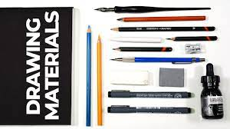

Slide 2
Pencils
The “lead” pencil is familiar to everyone, however, it is not and never was made from lead but from graphite, a type of carbon that is mixed with clay and baked. Graphite pencils are best sharpened using a sharp craft knife rather than a pencil sharpener. They are graded from hard (H) to soft (B). 9H is the hardest whereas 9B is the softest, with F (for fine) and HB in the middle range. H pencils (2H, 3H, and 4K; they progressively become harder) are good for clear-cut, light lines, but will scratch into the surface of your paper, so B pencils are better for softer, tonal work.
Each grade of pencil will only produce a tone of a given darkness and no amount of pressure will make that tone darker. If you require a darker tone, you will need to switch to a softer grade of pencil. Soft pencils will give a greater range of tones than hard pencils and can be erased without leaving an indent should you make a mistake. It is for this reason that most drawings are made using a pencil which is HB or softer. Aim to use a 2B or 3B to start your drawing and switch to a softer—or blacker—pencil, such as a 6B or a 9B, for deeper tones.
Most mechanical pencils, also known as clutch or propelling pencils, are good for precision work, but the softest grades are not easy to find.

Slide 3
Coloured pencils
Colored pencils are made in much the same way as graphite pencils. The pigment is mixed with a clay filler and a binder. Wax is added to act as a lubricant and help the pencil slide smoothly over the paper.
These are available in many different colors and forms, such as standard, water-soluble, and thick- and thin-leaded, and they vary in quality and softness. Unlike pastel pencils, colored pencils do not need to be sprayed with a fixative. Some colored pencils make sharp, definite lines, while others are softer and can be blended more easily. Layering colors will produce different shades and unexpected results can be achieved by using the same group of colors in different sequences, so it’s worth experimenting to find out the best order for a particular shade.

Slide 4
Charcoal sticks and pencils
These are essentially charred wood and are one of the oldest drawing materials. Made from carbonized wood (usually willow, but beech and vine can also be found), the sticks are graded as soft or hard and come in four thicknesses: thin, medium, thick, and extra thick sticks. (Extra-thick sticks are also known as “scene painters’ charcoal.”) Thin sticks work well for fur, feathers, and other fine detail, while block charcoal works well for large areas.

Slide 5
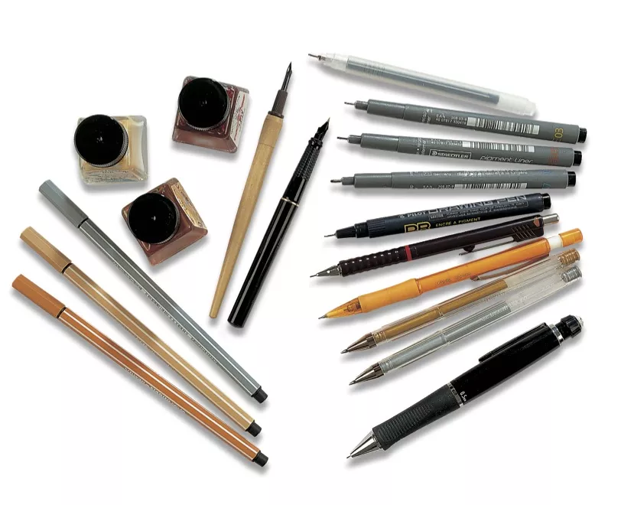
Pens
A very large range of pen options is available—so much so that it may seem a little overwhelming. Technical pens are convenient to use for fast sketches, but their nibs make unvarying marks. Fountain or cartridge pens, roller-ball, ballpoint, fineliners, and specialist art pens come with a wide range of nibs and can be used for both quick sketches and more detailed drawings. Ballpoint pens can be smooth and satisfying to use and are convenient for sketching. All pens can create fine, flowing lines, with smooth and subtle results.

Slide 6
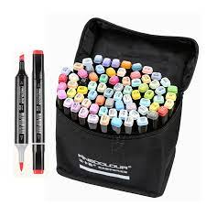
Professional markers
The body, cap and plugs of the marker are typically made out of a plastic resin while the reservoir (the part that holds ink) is made from polyester. The tip of the markers are composed of a powder and water mixture. The variation among markers really lies within the type of colorant. Types of marker colorants include dye, ink, or paint which can be dispersed within an alcohol, water, or solvent-based mixture. Synthetic substances, such as tuluol and xylol, have been used as solvents but can be pretty toxic. In some markers, these toxics have been substituted with much safer chemicals. Art markers are extremely simple to use and require very little prep time compared to other art mediums. Maintenance is fairly easy as you only need to store them properly (cool, dry area away from heat and sunlight) and some markers even are refillable for when you run out of ink. The ink from art markers dry immediately which is a HUGE plus for many artists. Like colored pencils, colors can actually be blended which is another great advantage for artists. However, unlike colored pencils, it can be extremely difficult to correct mistakes.

Slide 7
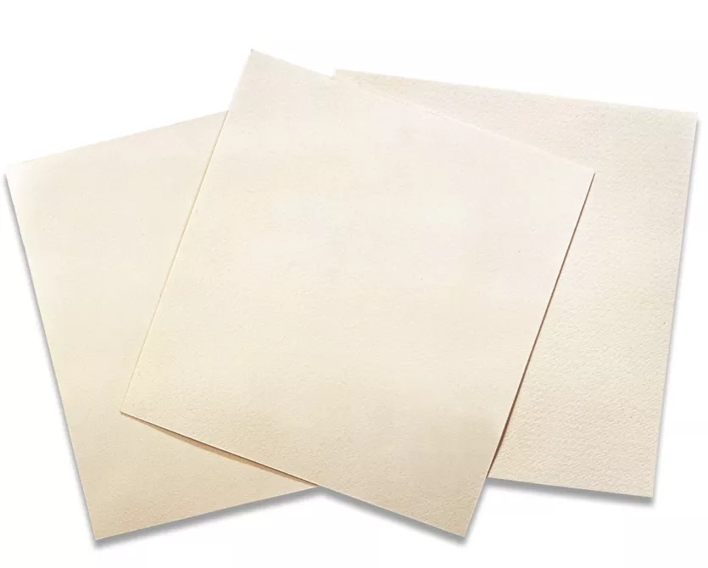
Papers and supports
Certain papers work best with certain media so it pays to match the drawing implement to the support. There are three distinct paper surfaces.
Rough is, as the name suggests, a paper with a pitted, highly textured surface. It is best suited to bolder, expressive work using charcoal, chalks, pastel pencils, and soft graphite.
Papers with a very smooth surface are known as “hot pressed” due to the fact that when being made the drying sheet of pulp is passed through hot steel rollers. These papers are best suited to pen and ink work, wash drawings, and fine pencil work and are less satisfactory when used with softly pigmented drawing tools like charcoal and chalk. This is because the pigment dust needs a textured surface to cling to.

