Slide 1
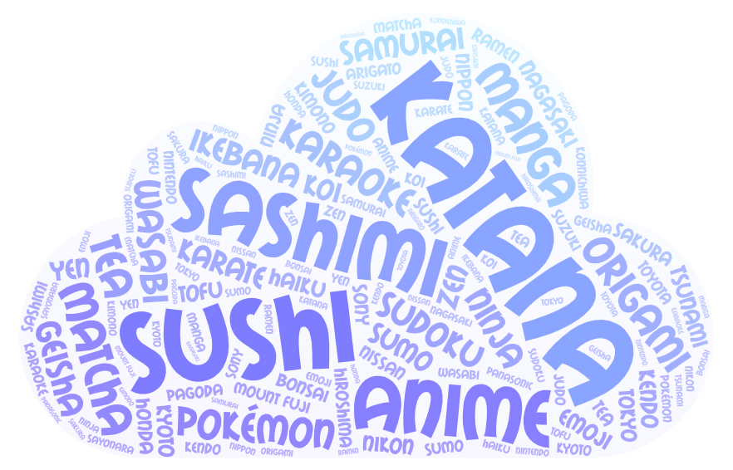
Guess the TOPIC!

Slide 2
Japan
Geography CLIL
Class 3
School year 2021-22

Slide 3
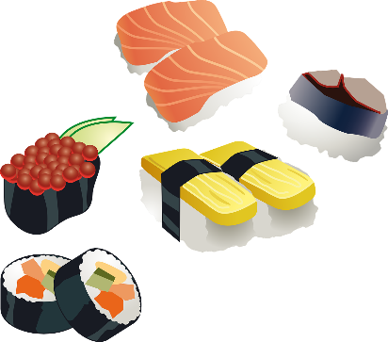
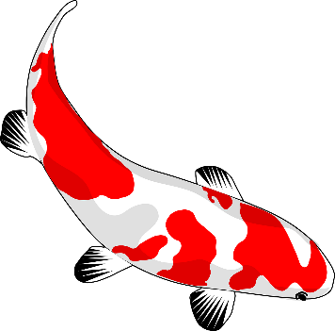
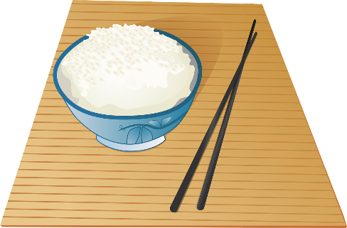
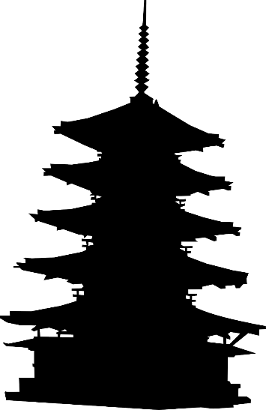
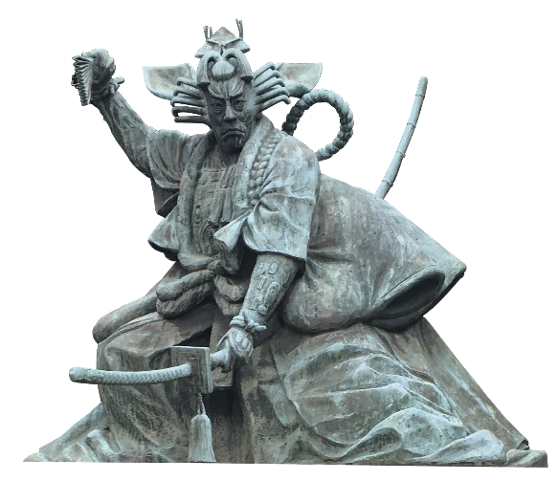
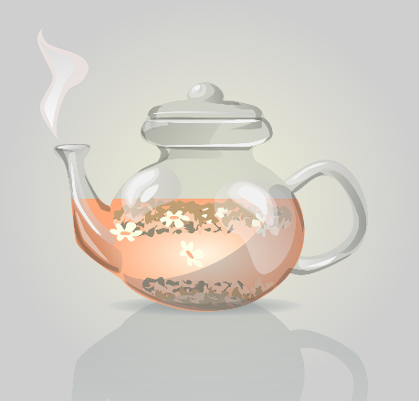
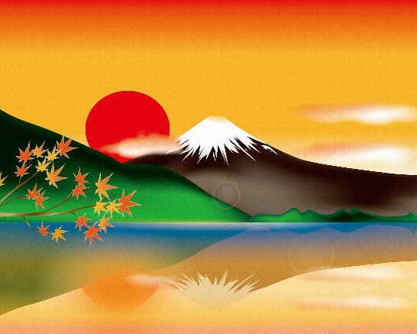
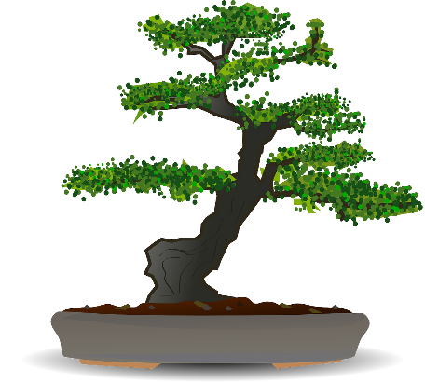
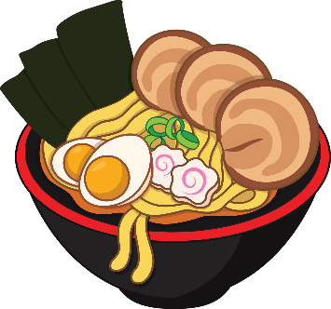
To warm up… Choose the right name for each picture!
Sakura (Cherry blossom)
Sushi
Fan
Koi (Carp)
Origami
Kimono
Rise
Noodles
Samurai
Tea
Mount Fuji
Bonsai
Pagoda

Slide 4
Look on the map…
In what continent is Japan?
Is it a mainland country, a peninsula, an island…?

Slide 5
Map skills
Click on the globe for an interactive map of Japan
Label the map with:
Countries, seas/ocean:
Russia – China – North Korea – South Korea – Sea of Japan – Pacific Ocean – Philippine Sea – Sea of Okhotsk – East China Sea – Seto Inland Sea
Islands:
Hokkaido – Shikoku – Kyushu - Honshu
Towns:
Tokyo – Kyoto – Hiroshima – Nagasaki

Slide 6
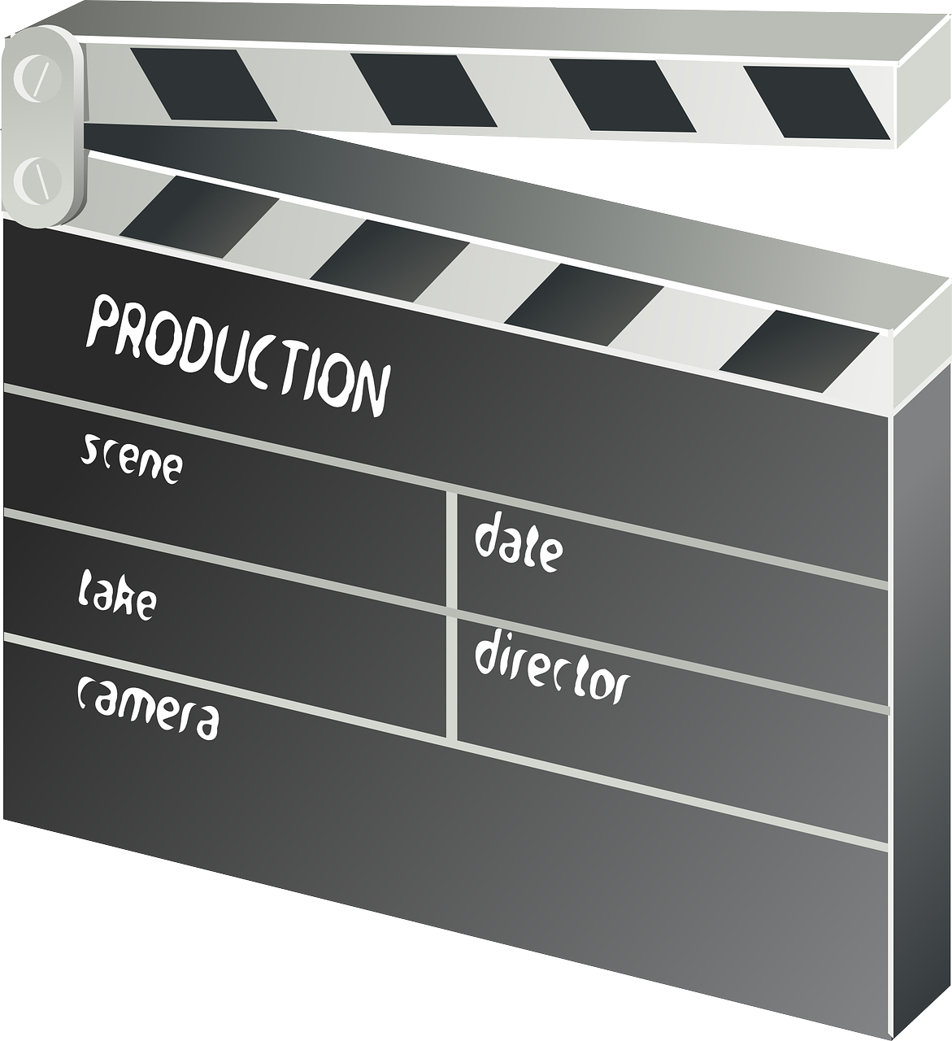
Geography of Japan
The words you need:
chain = catena
earthquake = terremoto
Watch the video and answer the questions.
Japan is located off the East-coast of ___________. The four main islands of Japan are:
Japan is: 1) ____________________
□ a mainland country 2) ____________________
□ a series of islands 3) ____________________
A chain of islands is an __________________. 4) ____________________
The number of people living in a space is called population _____________.
Japan has a very low / high population density.
The landscape of Japan doesn’t influence / influences where people live.
About ______ of Japan is mountainous.
______ of the world’s active volcanoes are located in Japan.
Seismic activity in Japan is made by volcanoes, earthquakes and ____________.

Slide 7
Geography of Japan - answers
Watch the video and answer the questions.
Japan is located off the East-coast of __Asia___. The four main islands of Japan are:
Japan is: 1) ______Honshu_______
□ a mainland country 2) ______Kyushu_______
a series of islands 3) ______Shikoku_______
A chain of islands is an ___archipelago____. 4) ______Hokkaido______
The number of people living in a space is called population ___density____.
Japan has a very low / high population density.
The landscape of Japan doesn’t influence / influences where people live.
About __70%__ of Japan is mountainous.
__10%__ of the world’s active volcanoes are located in Japan.
Seismic activity in Japan is made by volcanoes, earthquakes and ___tsunamis___.

Slide 8
Homework
For our next lesson, search on the Internet to find the missing information!
Superlatives of Japan
Biggest mountain range:
Highest peak:
Most active volcano:
Largest lake:
Longest river:
Biggest island:

Slide 9
Check your answers!
Superlatives of Japan
Biggest mountain range: JAPANESE ALPS
Highest peak: MOUNT FUJI
Most active volcano: MOUNT ASO
Largest lake: LAKE BIWA
Longest river: SHINANO RIVER
Biggest island: HONSHU

Slide 10
Main facts
The flag
The circle in the middle of the flag represents the sun. White stands for integrity and honesty.
The words you need:
currency = type of money
Official name: Japan (also known as Nippon, “the land of the rising sun”)
Area: 377,835 km²
Capital city: Tokyo
Population: almost 126,000,000
Official language: Japanese
Form of government: Constitutional monarchy* (with a Parliamentary system)
Religions: Shinto* (69%), Buddhism (67%), Christian (1,5%)
Currency: Yen

Slide 11
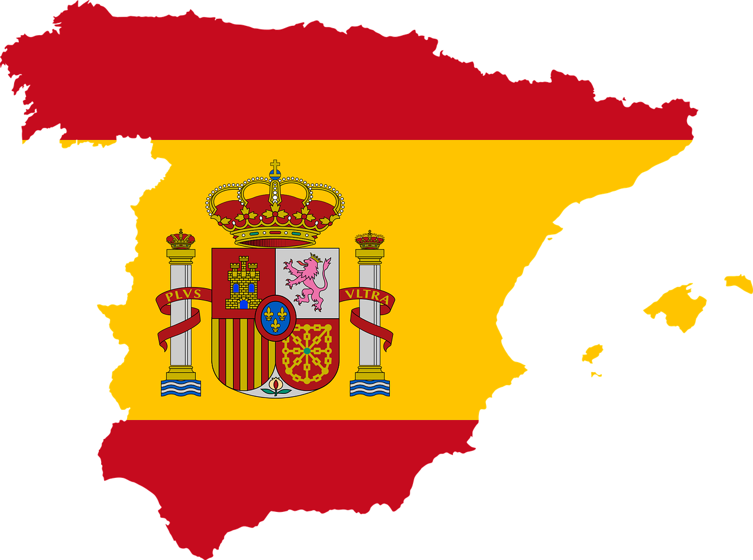
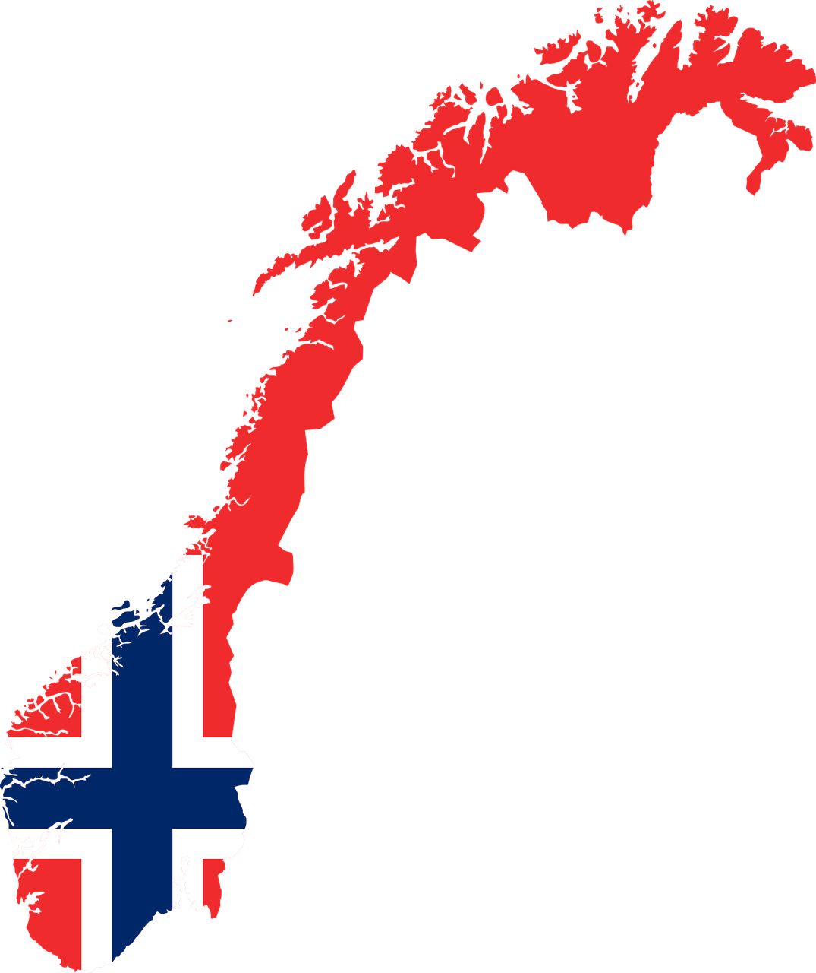
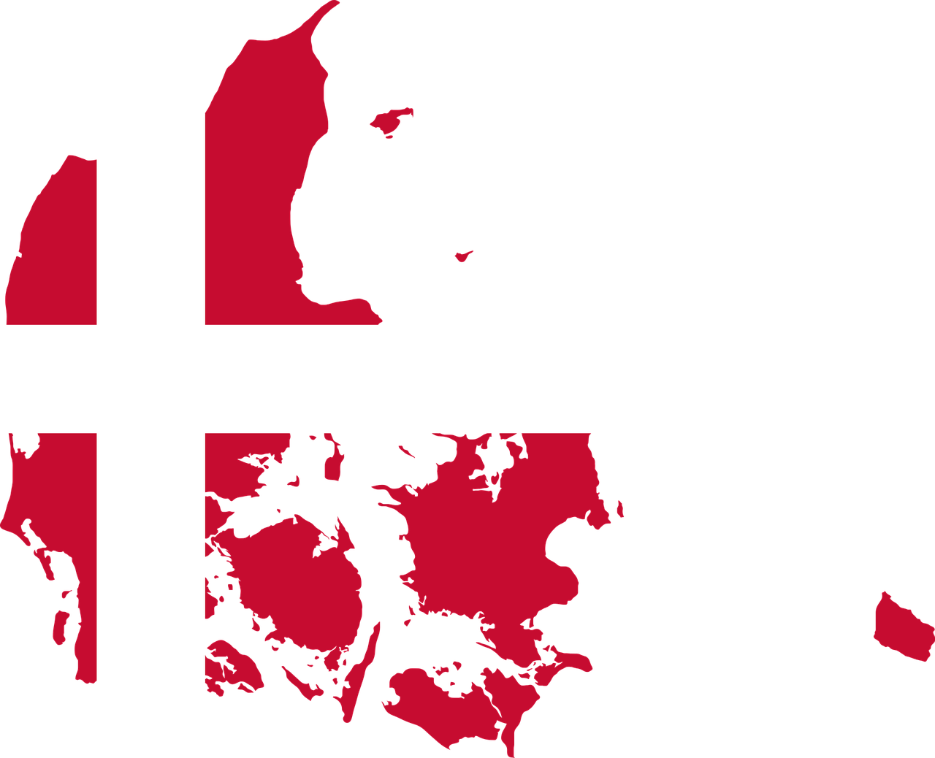
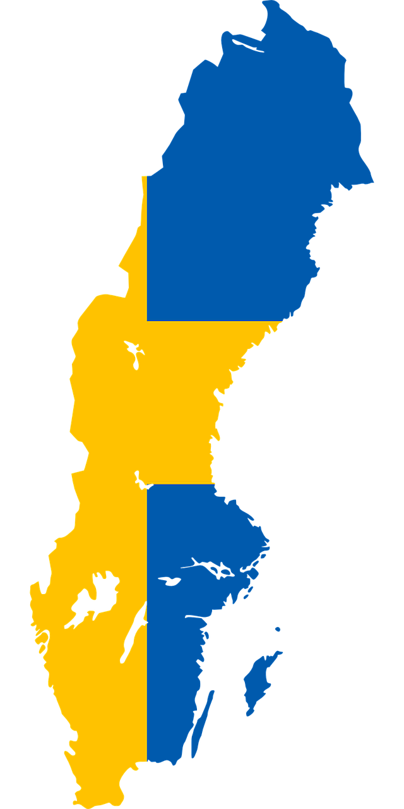
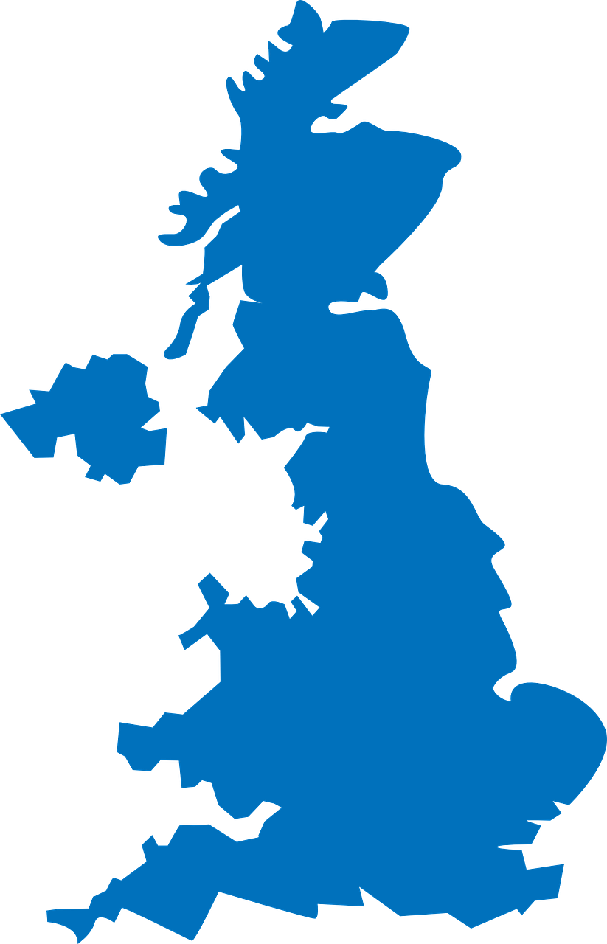
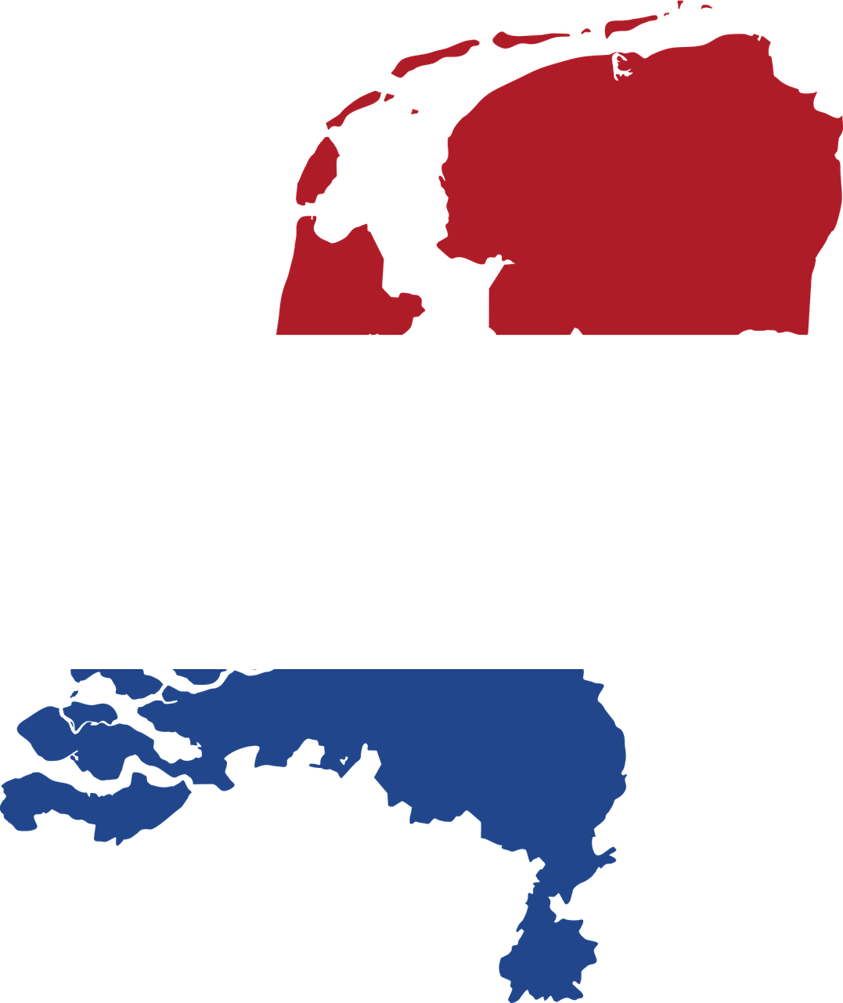
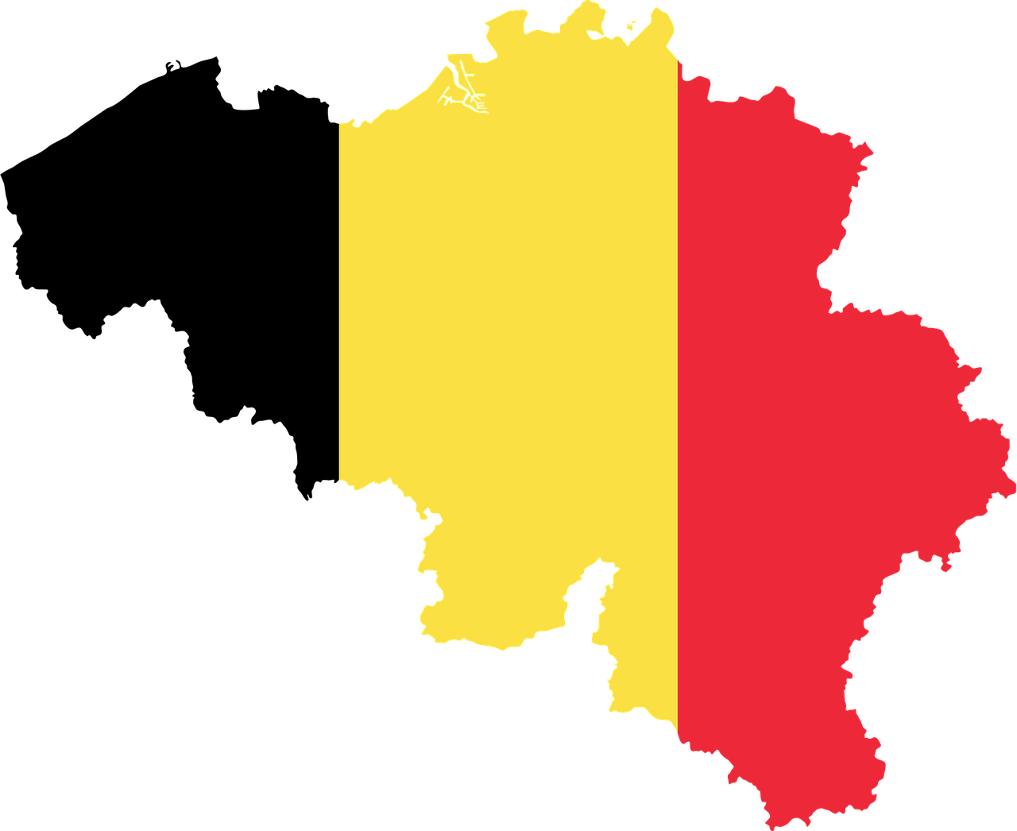
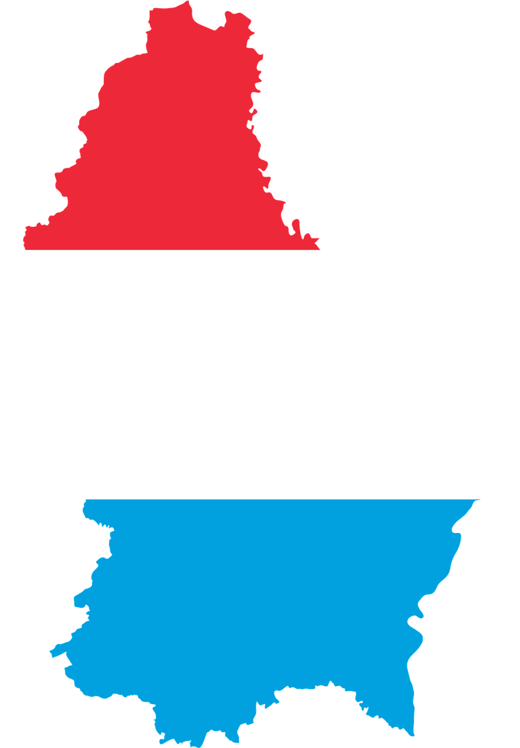
Do you remember what a CONSTITUTIONAL MONARCHY is?
Make some examples of countries
with a constitutional monarchy…

Slide 12
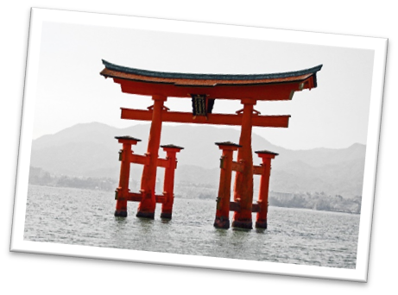
Focus on…
The words you need:
polytheistic = with many gods
offering = gift
blessing = benedizione
shrine = tempio
emperor = imperatore
Shinto means “the way of the kami (= gods)”.
It is a polytheistic religion: there are different kami, who live in everything that is part of nature (e.g. trees, water, rocks…).
People make offerings (food and drinks) to get kami’s blessing.
At the entrance of the shrine, there is a torii, a gate that marks the passage to a sacred place.

Slide 13
Japan’s monarchy is the oldest in the world: it started in the 6th century!
In the past, the emperor was very powerful, and many Japanese people believed he was a god. Now, he has only a symbolic power: it represents the country's traditions and unity.
The actual emperor is Naruhito.

Slide 14
Pair work
What does Nippon mean?
Ask each other questions about the main facts of Japan.
Try to answer without reading!
What is the most important religion in Japan?
Can you describe the Japanese flag?
Who is the actual emperor of Japan?

Slide 15
Climate
Before reading…
The words you need:
main = principal
to vary = to change
cool = fresco
mild = mite
heavy = pesante
typhoon = tifone

Slide 16
Text adapted from https://doyouknowjapan.com/climate/
Read the text and colour the map in different colours (one for each climatic zone).
Climate in Japan is very different from one region to another. However, there are six main climatic zones:
1. North of Japan: there is a humid continental climate: winters are long and cold, while summers vary from cool to very warm.
2. Sea of Japan coast: in winter there is a lot of snow; summers are cooler and less rainy.
3. Pacific coast: there is a humid temperate climate with mild winters and hot summers with heavy rain.
4. Central Highland: there is a humid continental climate, with large temperature differences between summer/winter, day/night. There are few precipitations, but in winter there is a lot of snow.
5. Seto Inland Sea coast: the climate is mild all year (similar to the Mediterranean climate).
6. Ryukyu Islands: there is a subtropical climate, with very hot summers and warm winters. During the typhoon season, there is a lot of rain.

Slide 17
Legend
North of Japan
Sea of Japan coast
Pacific coast
Central Highland
Seto Inland Sea coast
Ryukyu Islands

Slide 18
Economy
Before reading…
The words you need:
suitable = good for clam = vongola
rise = riso eel = anguilla
wheat = grano goods = beni, merci
fleet = flotta insurance = assicurazione
crab = granchio retailing = commercio al dettaglio
shrimp = gamberetto Stock Exchange = borsa (finanza)
squid = calamaro

Slide 19
Economy
Look at the diagram and the pie chart and write a short text about Japan’s economy.

Slide 20
Sample text:
Japan’s economy is very strong: it is the 3rd largest economy in the world.
The most important sector is the tertiary sector: it makes up 71,40% of the GDP of Japan.
In this sector, the most important activities are telecommunications, transports, retailing, insurance and banking. In fact, the Tokyo Stock Exchange is the 3rd largest in the world.
In this sector, tourism is also very important, because Japan is Asia’s most visited country.
The secondary sector makes up 27,50% of Japan’s GDP. The most important industries are fishing, car manufacturing, electronics and high-tech and precision goods (including robots).
The least important sector is the primary sector: it makes up only 1,20% of the GDP.
In this sector, agriculture isn’t very important because only 12% of the land is suitable for agriculture. In fact, Japan relies on import for most of these products: Japan is the 2nd largest agricultural product importer in the world. However, rice is the most important crop. Other crops are wheat, mandarin and apple.
Fishing, instead, is very important in this sector: Japan has the largest fishing fleet in the world. They fish sardines, tuna, crab, shrimps, salmon, squid, clams, trout, eel and many other types of fish.

Slide 21
Culture and traditions
The words you need:
last = l’ultima volta
sacred = sacro
climb = scalare
Mount Fuji
It is the highest mountain in Japan: it is 3776 m. It is a dormant (“sleeping”) volcano: it last erupted in 1707, but it could erupt again.
Shinto people consider it a sacred place.
A lot of people visit it every year: it takes about 9 hours to climb!

Slide 22
Culture and traditions
The words you need:
ceremony = cerimonia
monk = monaco
involve = comportare, prevedere
host = ospite
mat = tappetino
to last = durare
several = many
Tea ceremony
Tea ceremonies were introduced in Japan in the 12th century by Buddhist monks coming from China.
The traditional ceremony involves specific rituals: they use matcha (a type of green tea), the host and visitors wear a kimono, and they sit on a tatami mat on the floor of the tearoom.
The ceremony can last several hours.

Slide 23
Culture and traditions
The words you need:
seasoned = condito
available = disponibile
seaweed = alghe
raw = crudo
chopsticks = bacchette
dish = piatto
Sushi
Sushi means “seasoned rice” in Japanese.
Japanese people eat very little meat: they use what is available to them, like rice, seafood, seaweed and vegetables.
Sushi are rice rolls with raw fish slices. They are usually eaten with chopsticks.
A legend says that one thousand years ago, the emperor was travelling through Japan. He stopped at the house of a poor fisherman to eat, but the fisherman only had some rice and raw fish to give him. However, the emperor liked the dish so much that he made the fisherman his personal chef!

Slide 24
Culture and traditions
The words you need:
carp = carpa
brave = courageous
was chosen = è stato scelto
kite = aquilone
in the shape of = a forma di
Koi
Koi means “carp”. Carps are very strong and brave: they can swim up waterfalls. This is why originally the carp was chosen as the symbol of boys.
On Children’s Day, the 5th May, families put kites in the shape of carps outside their homes: the large carp represents the father, the medium carp the mother, the smaller carps represent the children.

Slide 25
Homework
For our next lesson, choose one of the remaining symbols of page 1 of your photocopies and prepare a poster about it.

Slide 26
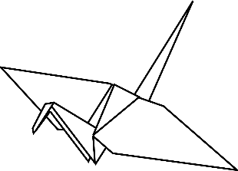
1,000 paper cranes
Before reading…
The words you need:
take part = participate
to sign = firmare
agreement = accordo
to force = make someone do something
ally = alleato
weapon = arma
drop = far cadere
take place = avvenire
surrender = arrendersi
exposure = esposizione
fold = piegare
crane = gru
grant = concedere, accordare
recovery = ristabilirsi, riprendersi
disease = malattia
raise money = raccogliere soldi

Slide 27
Japan and World War II
Fill in the text with these words:
radiation exposure
atomic bomb
attack on Pearl Harbor
Nagasaki
1945
1940

Slide 28
Text
Japan took part in the final years of World War II: in September ________, it decided to sign an agreement with Italy and Germany called the Tripartite Pact.
The Japanese ________________________ (Hawaii islands) in December 1941 forced the USA to enter the conflict.
From 1941 to 1945, Japan fought against the USA and its allies.
In May ________, the war had ended in Europe but was still going on in the East. So, the US President Harry Truman decided to use a new powerful weapon to end the conflict. The first ________________ was dropped on the 6th August 1945 on the city of Hiroshima: it killed 100,000 people.
Three days later, a second attack took place against ________________ and other 200,000 people were killed. Many people died in the following years because of _________________________.
On the 14th August Japan surrendered: World War II was over.

Slide 29
Text - answers
Japan took part in the final years of World War II: in September 1940, it decided to sign an agreement with Italy and Germany called the Tripartite Pact.
The Japanese attack on Pearl Harbor (Hawaii islands) in December 1941 forced the USA to enter the conflict.
From 1941 to 1945, Japan fought against the USA and its allies.
In May 1945, the war had ended in Europe but was still going on in the East. So, the US President Harry Truman decided to use a new powerful weapon to end the conflict. The first atomic bomb was dropped on the 6th August 1945 on the city of Hiroshima: it killed 100,000 people.
Three days later, a second attack took place against Nagasaki and other 200,000 people were killed. Many people died in the following years because of radiation exposure.
On the 14th August Japan surrendered: World War II was over.

Slide 30
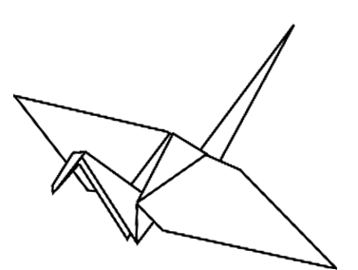
Sadako Sasaki
If you fold 1,000 cranes you will be granted a wish.
~ Japanese legend
Click on the crane to watch a short video about Sadako

Slide 31
Choose the title for each paragraph.
Changing dream
A monument for children and peace
Hiroshima bombing
Wishing on a crane

Slide 32
__________________________________
Sadako Sasaki was only two years old when the bomb was dropped on Hiroshima, 2 km far from where she lived. But she survived.
__________________________________
Ten years later, when the world around her was starting to feel normal again, she found out that she had contracted “atomic bomb disease”.
Sadako was devastated, but she did not give up: she started to fold cranes, wishing for her recovery.
__________________________________
As time passed, Sadako slowly accepted that she was not going to recover. She changed her prayer and wished for peace in the world.
Even when she was too weak, she kept on folding cranes. She died on 25th October 1955.
__________________________________
After her death, her friends and classmates raised money to build a monument for her and all the children who died from the effects of the atomic bomb: the Children’s Peace Monument, in Hiroshima Peace Park.
On the top of the monument, there is a statue of Sadako holding an origami crane.
Text adapted from https://origamiexpressions.com/sadako-sasaki and https://sadakosasaki.com/

Slide 33
Hiroshima bombing
Sadako Sasaki was only two years old when the bomb was dropped on Hiroshima, 2 km far from where she lived. But she survived.
Wishing on a crane
Ten years later, when the world around her was starting to feel normal again, she found out that she had contracted “atomic bomb disease”.
Sadako was devastated, but she did not give up: she started to fold cranes, wishing for her recovery.
Changing dream
As time passed, Sadako slowly accepted that she was not going to recover. She changed her prayer and wished for peace in the world.
Even when she was too weak, she kept on folding cranes. She died on 25th October 1955.
A monument for children and peace
After her death, her friends and classmates raised money to build a monument for her and all the children who died from the effects of the atomic bomb: the Children’s Peace Monument, in Hiroshima Peace Park.
On the top of the monument, there is a statue of Sadako holding an origami crane.
Text adapted from https://origamiexpressions.com/sadako-sasaki and https://sadakosasaki.com/

Slide 34
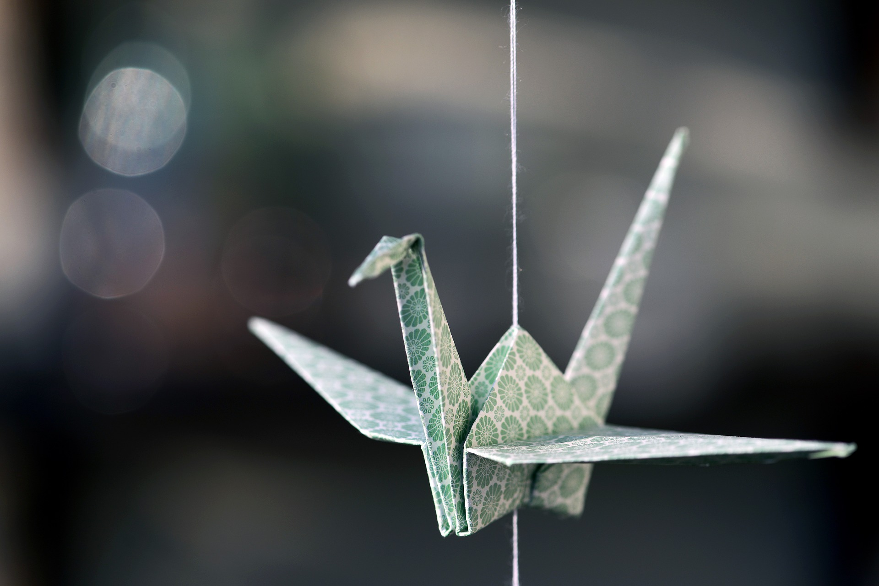
Let’s try folding a paper crane!

Slide 35
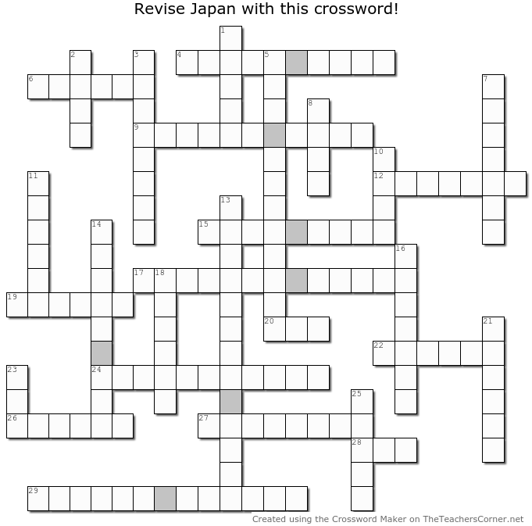
Time to revise!

Slide 36
Crossword answers

Slide 37
Revision: geography of Japan

Slide 38
Sources
Atlante della vita quotidiana Junior, DoGi spa (Firenze), Touring Editore, 2003
Percorsi CLIL di Geografia, a cura di P. E. Balboni, Loescher editore, 2015
Geography of the World: the Essential Family Guide to Geography and Culture, edited by S. Adams and A. Ganeri, DK Publishing, 2006
History, Geography, Art CLIL, A. Carraglia, Pearson, 2017
https://www.britannica.com/place/Japan/People
https://www.kids-world-travel-guide.com/japan-for-kids.html
https://kids.nationalgeographic.com/geography/countries/article/japan
https://doyouknowjapan.com/climate/
https://www.worldatlas.com/articles/the-economy-of-japan.html
https://en.wikipedia.org/wiki/Economy_of_Japan
https://www.worldometers.info/world-population/japan-population/
https://en.wikipedia.org/wiki/Religion_in_Japan
https://en.wikipedia.org/wiki/Shinto
https://www.edarabia.com/japan/flag/
https://origamiexpressions.com/sadako-sasaki
https://sadakosasaki.com/

Slide 39
Resources (images, video, maps)
IMAGES and MAPS:
Pixabay open sources images
https://en.wikipedia.org/wiki/Japan
https://d-maps.com/carte.php?num_car=354&lang=it
https://upload.wikimedia.org/wikipedia/commons/5/54/Atomic_bombing_of_Japan.jpg
https://commons.wikimedia.org/w/index.php?curid=89645372
http://www.disegni-da-colorare-gratis.it/index.php/Geografia/Bandiere/Bandiera-del-Giappone-da-colorare-per-ragazzi
VIDEO:
Geography of Japan: https://www.youtube.com/watch?v=Ob7UhHBI7Oc
Sadako and the 1,000 paper cranes: https://www.youtube.com/watch?v=KtZeH77ikcM
Origami tutorial: https://www.youtube.com/watch?v=pqeI94Jri1M

