Slide 1
The apPendicular skeleton AND JOINTS
Lesson 4 – 2° year middle school
U2_L4_ALL2

Slide 2
WHAT IS THE APPENDICULAR SKELETON?
While the axial skeleton makes up the inner framework or trunk of the body, the appendicular skeleton includes the outer limbs and the bones that connect the limbs to the center or trunk of the body.
These are the movable pieces - the arms and the legs - that allow the body to move. Without the appendicular skeleton, the axial skeleton - the head, ribs and spinal column - wouldn't be able to go anywhere
https://commons.wikimedia.org/wiki/File:Appendicular_Skeleton.png

Slide 3
WHAT IS THE APPENDICULAR SKELETON?
Let's take a look at some of the members of the appendicular skeleton.
The upper limbs include the bones of the arms and hands.
These are attached to the top of the rib cage by the pectoral girdle.
The lower limbs include the leg and foot bones.
These are attached to the lower part of the spinal column by the pelvic girdle.
All together, the appendicular skeleton contains about 126 bones - that's 60% of all the bones in the human body!
https://commons.wikimedia.org/wiki/File:Appendicular_skeleton_-_lateral_view.png

Slide 4
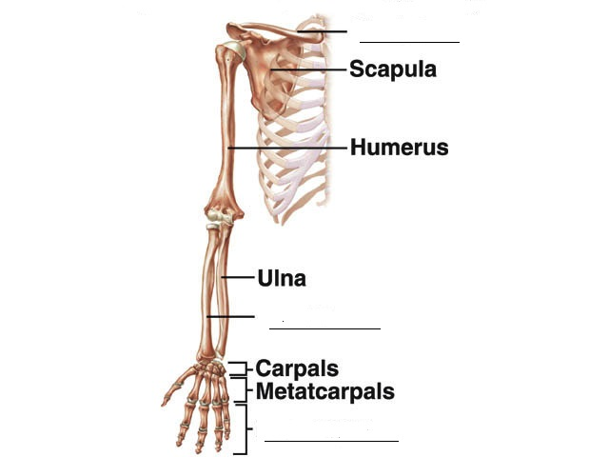
CLAVICLE
RADIUS
PHALANGES

Slide 5
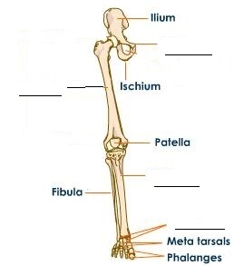
PUBIS
FEMUR
TIBIA
TARSALS

Slide 6
The Joints of the Skeletal System
Fixed joints
These joints are held together by tough tissue which develops during childhood.
They don’t allow any movement.
Examples include: the Cranium, pelvis and vertebrae
https://commons.wikimedia.org/wiki/File:Figure_38_03_01.jpg

Slide 7
The Joints of the Skeletal System
Slightly moveable joints
Here, movement is needed but only to a certain point e.g the vertebral column
Individual vertebrae are separated by cartilage.
They allow a limited number of movements.

Slide 8
The Joints of the Skeletal System
Moveable joints
These joints are also called synovial and allow movement to take place.
There are 6 types of freely moveable joints.
They allow a wide range of movements.
Eg. Elbows and knees

Slide 9
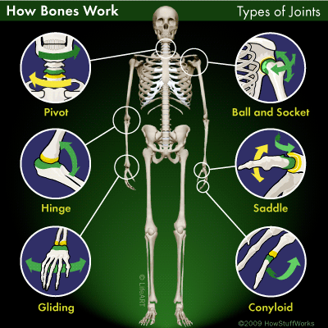
https://www.tes.com/lessons/ll5Ft2kXW4kTSw/10-1-the-skeletal-and-muscular-systems

