Slide 1
DER BLAUE REITER MARC & KANDINSKIJ

Slide 2
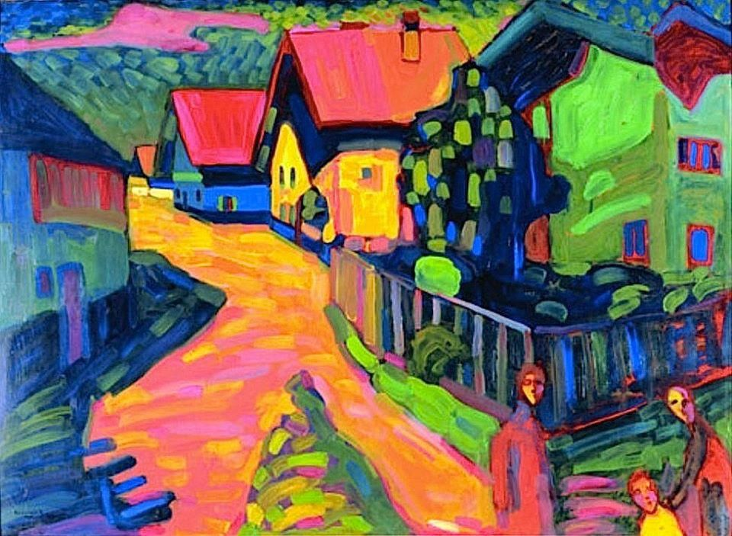
Notes:
Murnau Street, 1908

Slide 3
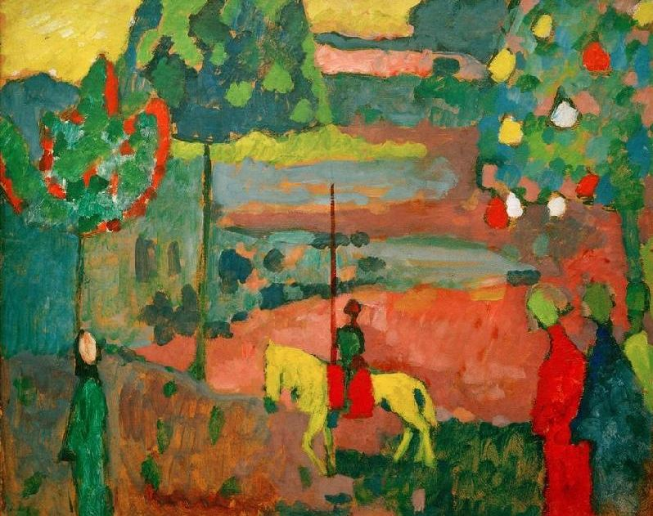
Notes:
Lancer in landscape, 1908

Slide 4
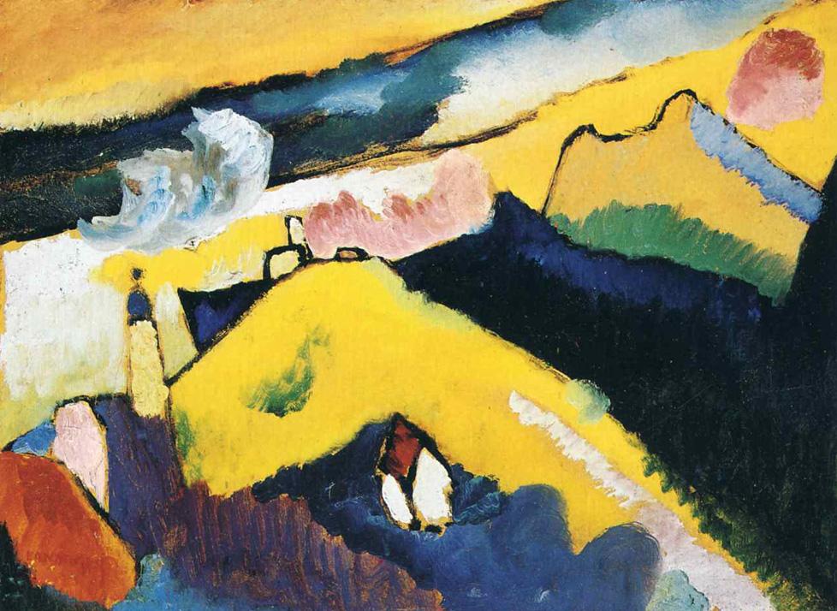
Notes:
Mountain landscape with church, 1910

Slide 5
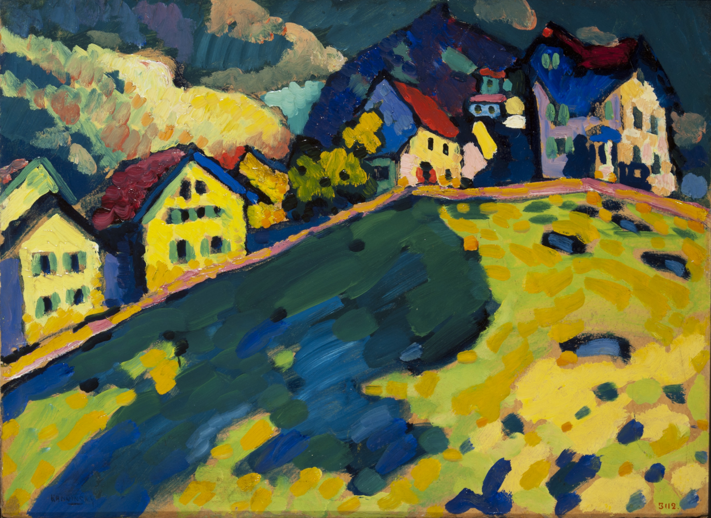
Notes:
Summer landscape

Slide 6
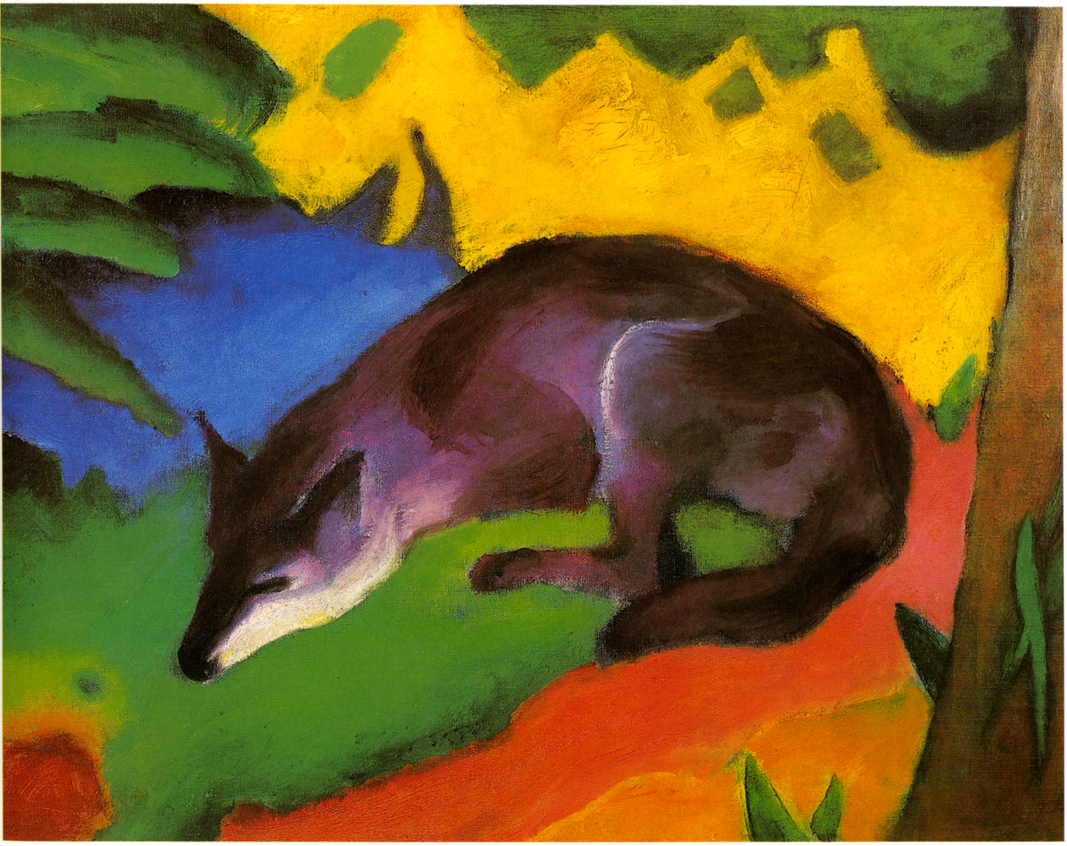
Notes:
Blue-black fox

Slide 7
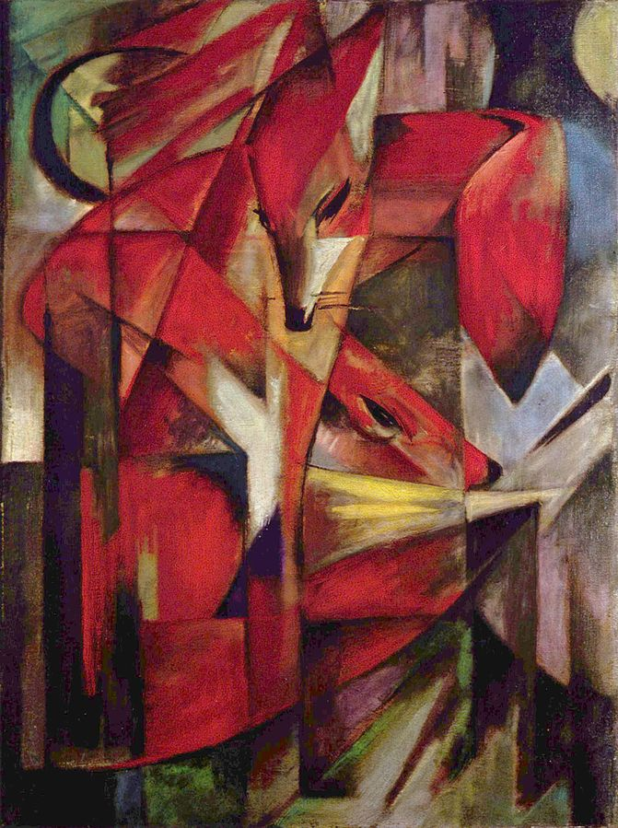

Slide 8
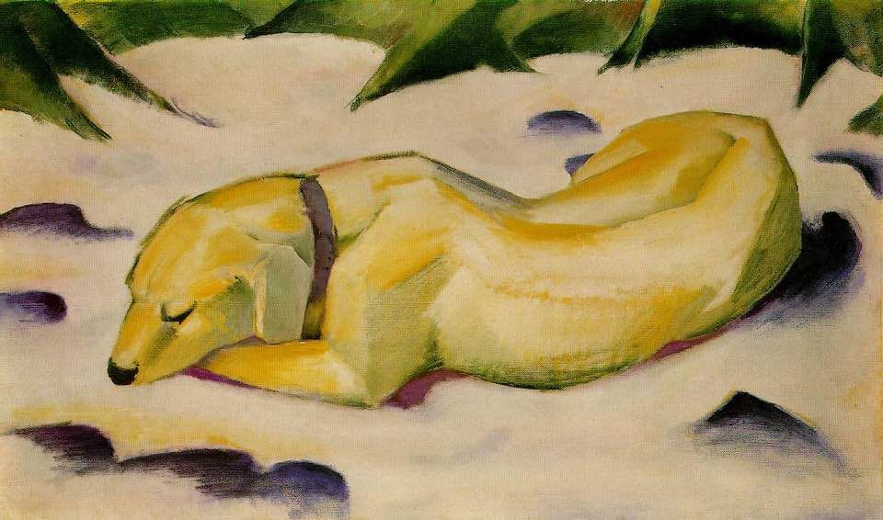
Notes:
Lying dog on snow

Slide 9
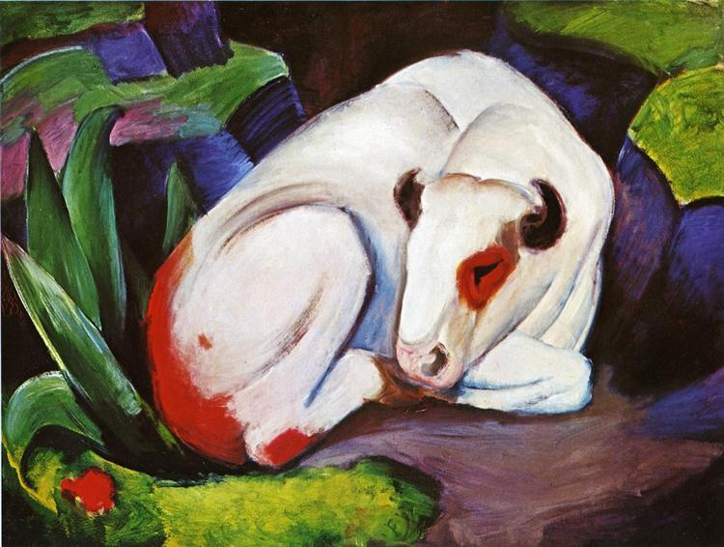
Notes:
The steer, 1911

