Slide 1
HTML: lists
Unit 3 – Lesson 1

Slide 2
Types of list
Bulletted list | Numbered list
Elements are not in order | Elements are put in order
<ul> is the tag to create it <ul> stands for unordered list | <ol> is the tag to create it <ol> stands for orderd list
<li> is the tag for each item
<li> stands for list item

Slide 3
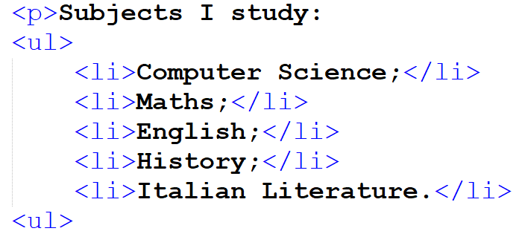
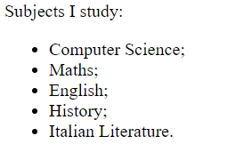
Analysis of a list
HTML document
Web page

Slide 4
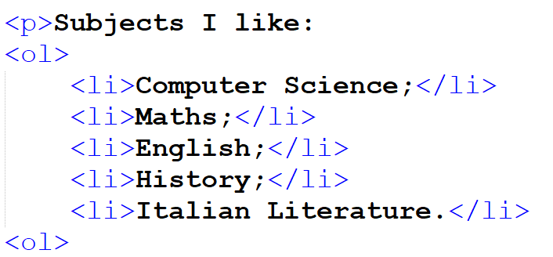
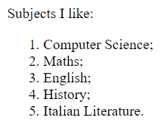
Analysis of a list
HTML document
Web page

Slide 5
Individual work
Create a web site on your favorite singer, with the usual folder structure
You can search on the Internet for information and pictures

Slide 6
The index.html page has to contain:
The title with the name of the singer
Info about him/her
A picture of him/her
A link to the page songs.html
The songs.html page has to contain:
The title «Songs»
A numbered list with the songs you prefer
A bulletted list with the websites you used to create this website
A link to go back the page index.html

