Slide 1
HTML: the structure of an HTML document and metatags
Unit 1 – Lesson 3

Slide 2
So far we know that…
Indentation is used to make the code more readable
Tags are nested inside other tags

Slide 3
Work in pairs
Analyse the following HTML document and indicate the main tags that contain the other ones

Slide 4
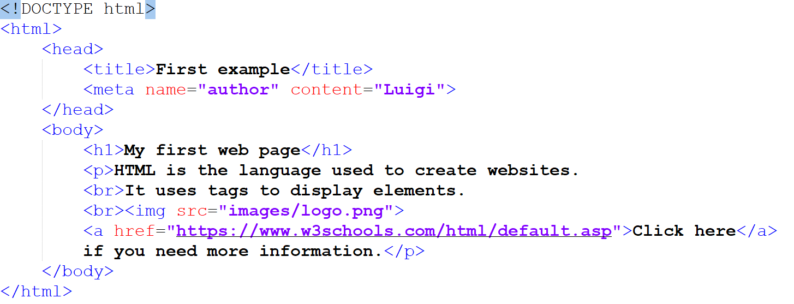

Slide 5
The structure of an HTML file: work in pairs and answer the following questions
What is the extension of an HTML file?
What is the root tag?
What are the two main tags (apart from the root tag)?

Slide 6
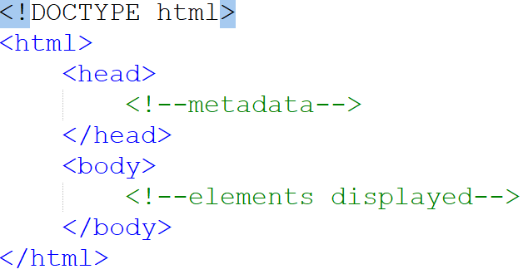
The structure of an HTML file

Slide 7
The structure of an HTML file
Green writings are comments; we comment the code to make it more readable

Slide 8
The structure of an HTML file
The extension of an HTML file is *.html

Slide 9
The structure of an HTML file
It is not a tag, but it is an information to the browser about what document type to expect; all HTML documents must start with this declaration

Slide 10
The structure of an HTML file
It is the root tag: it contains all the other tags

Slide 11
The structure of an HTML file
It contains metadata, information about the page; metadata will not be displayed on the page

Slide 12
The structure of an HTML file
It contains elements that will be displayed on the page

Slide 13
Meta tags
Tag name | Description | Example
title | It defines a title for the document | <title>My first page</title>
meta description | It describes the content of the document | <meta name="description" content="this is a simple HTML page">
meta keywords | It contains the keywords of the document for the search engine website | <meta name="keywords" content="HTML">
meta author | It defines the author for the document | <meta name="author" content="Luigi">

Slide 15
Individual work
Create a folder and name it as HTML – (today’s date)
Create an HTML page and save it in the folder as index.html
Use meta tags and comment each line

