Slide 1
Hello children
Here there are some activities: let’s have fun together!

Slide 2
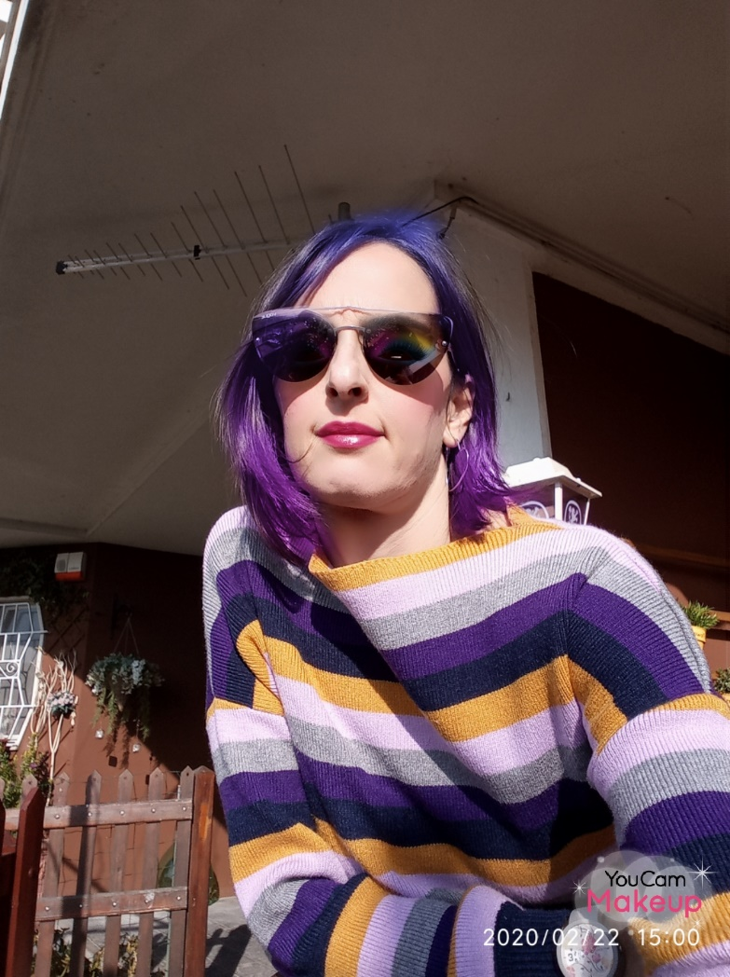

Here we are!
Hi! I’m your teacher Sara
( Rosaria).
Today we are going to talk about food.

Slide 3
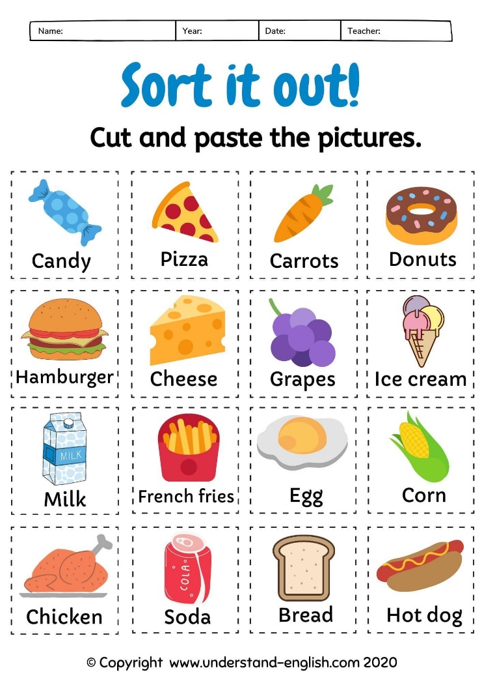
Let’s start!
Healthy unhealthy Healthy unhealthy

Slide 4
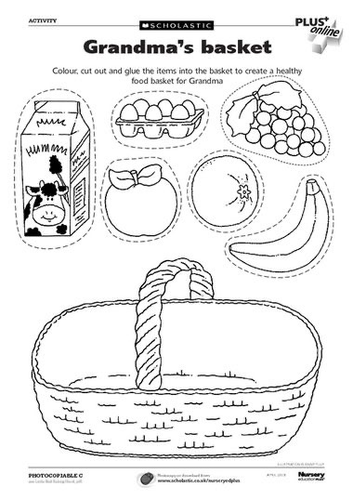

Are you ready for a pic-nic? What is in your basket? Look and answer.
I have got a BOTTLE/CARTOON of milk.
I have got SOME eggs.
I have got SOME fruits.
Immagini e canzone presa dal web

Slide 5
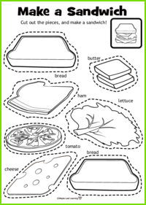
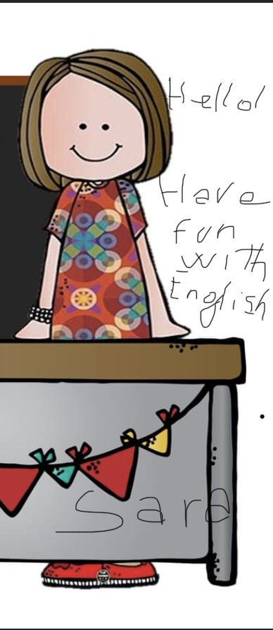
Make a sandwich!

Slide 6
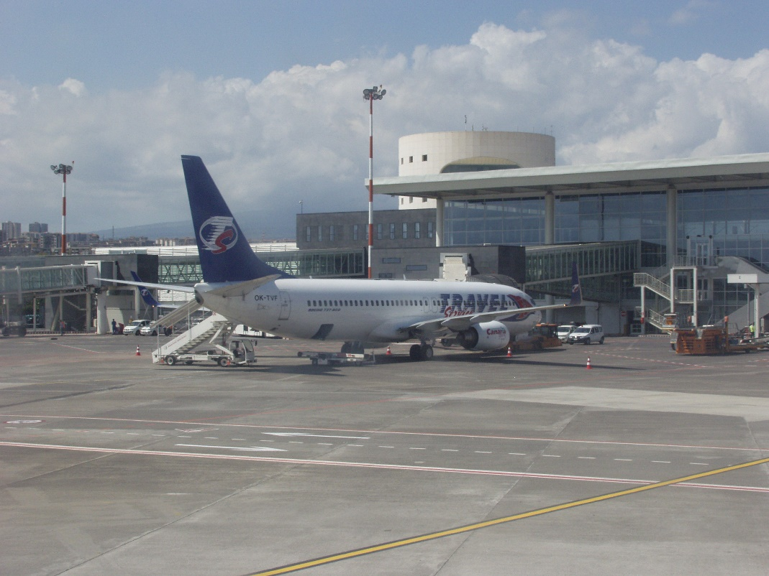
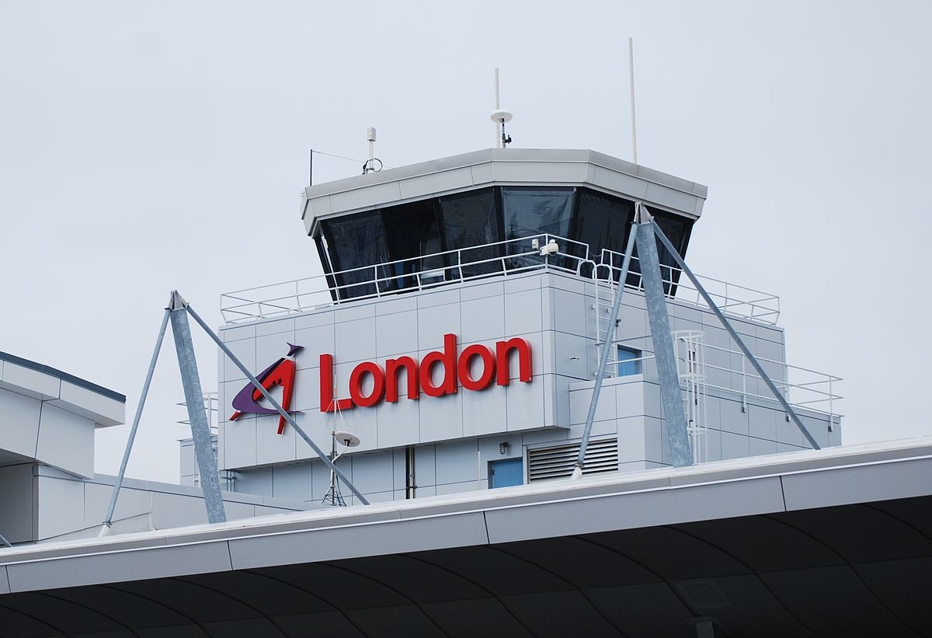
Let’s fly to London
We leave Catania---direction London

Slide 7

And now?
Welcome to London

Slide 8
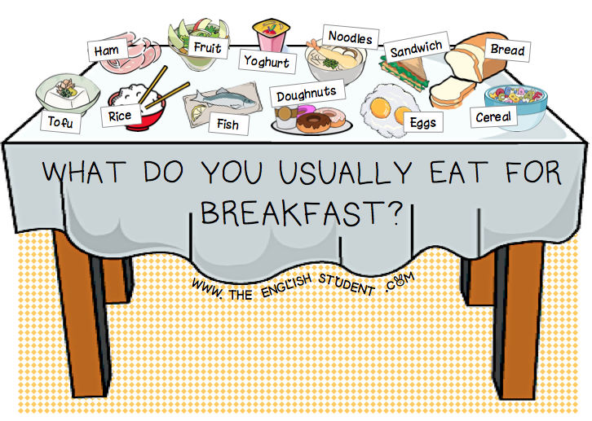
Eating time in Uk!

Slide 9
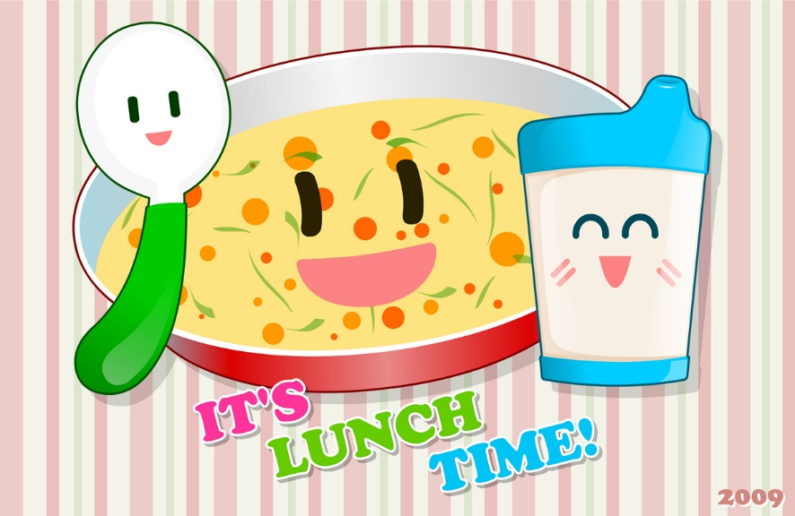
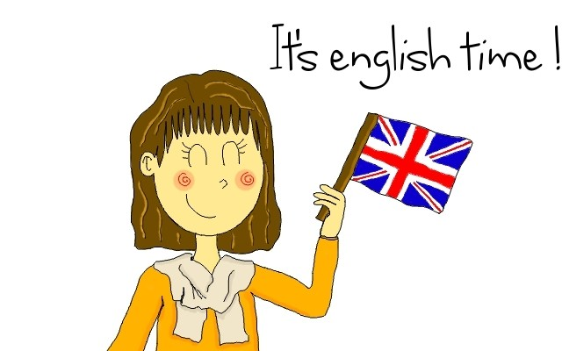
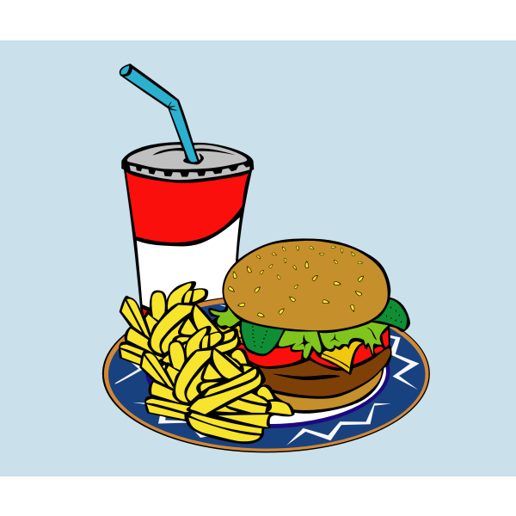
Eating time-

Slide 10
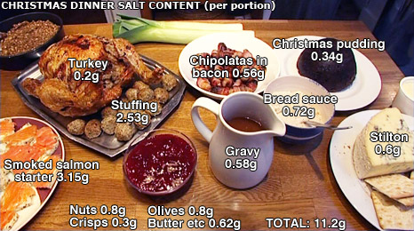
Eating time in Uk: It is Xmas Time

Slide 11
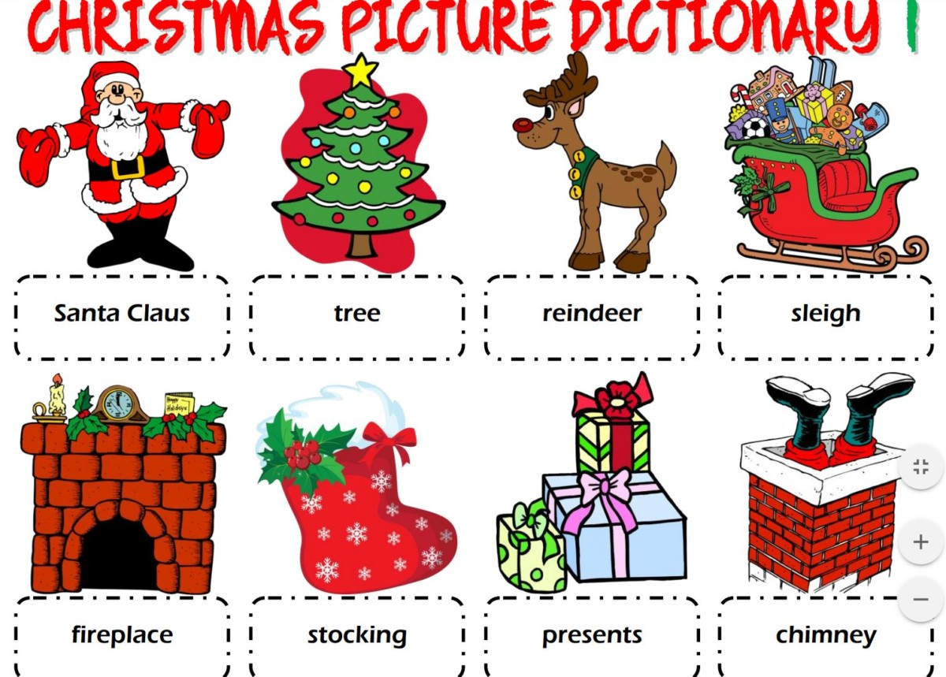
Have fun with me!

Slide 12
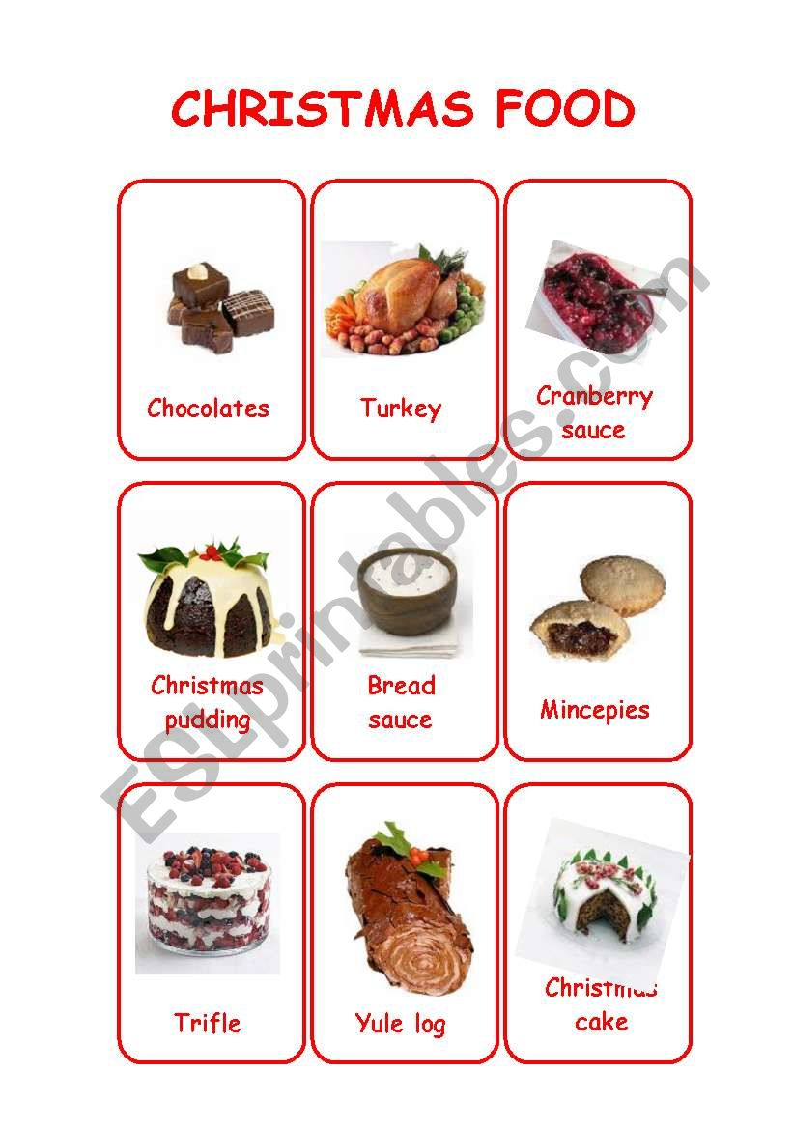
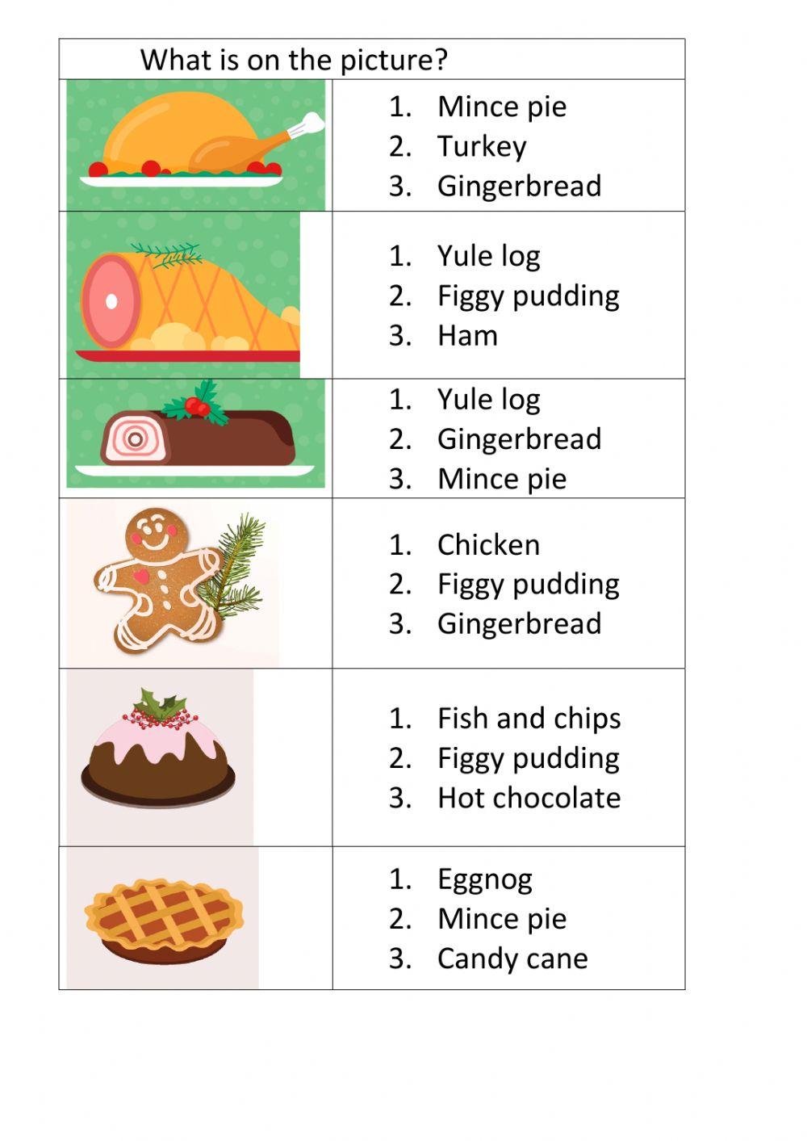
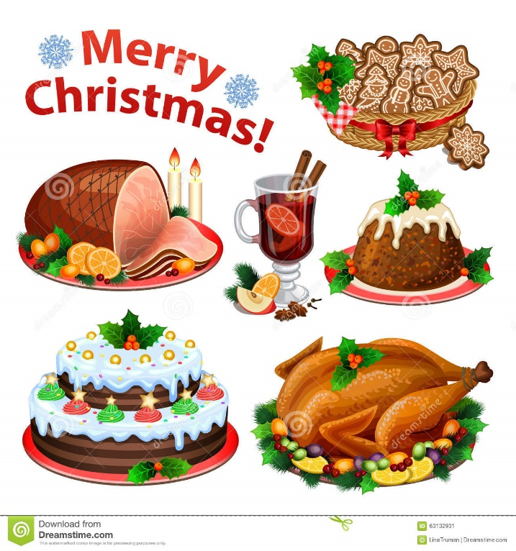
Xmas

Slide 13
Good bye ….
By teacher Sara

