Slide 1
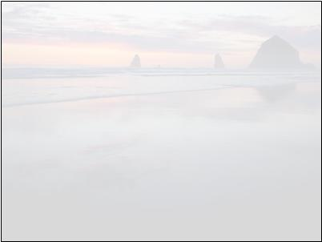
AFTER THIS PREZI OVERVIEWhttps://prezi.com/view/dSQSBuFPgA4kVomas8pK/
ANSWER THESE QUESTIONS:
Which is the most difficult part of the creative process?
The best part of the creative process is:
Write a short thought and find an appropriate image
Each student has two slides
NB: you can change the layout
Notes:
<numero>

Slide 2
Which is the most difficult part of the creative process?
Notes:
<numero>

Slide 3
The best part of the creative process is:
Notes:
<numero>

Slide 4

SOME EXAMPLES
Which is the most difficult part of the creative process?
Student 1: putting the pieces together

Slide 5

Which is the most difficult part of the creative process?
Student 2: finding the right path to follow

Slide 6
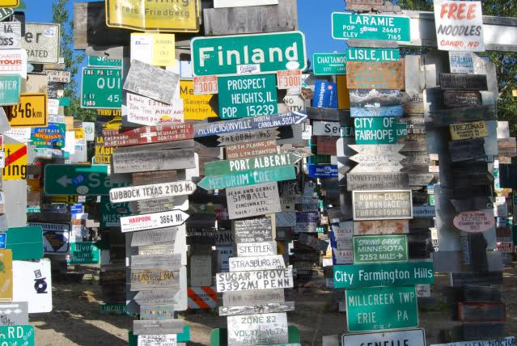
Which is the most difficult part of the creative process?
Student 3: drawing my ideas. I have so many ideas rushing through my head, I can't keep up!

Slide 7
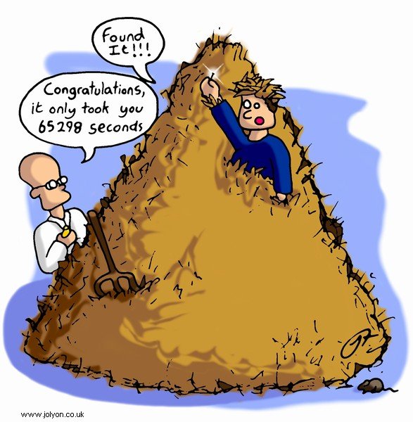
Which is the most difficult part of the creative process?
Student 4: Finding an idea for me is like looking for a Needle in a Haystack!!!
Notes:
<numero>

Slide 8

The best part of the creative process is:
Students 5: ...when the teacher talks to us about planing and we can express our ideas freely

Slide 9
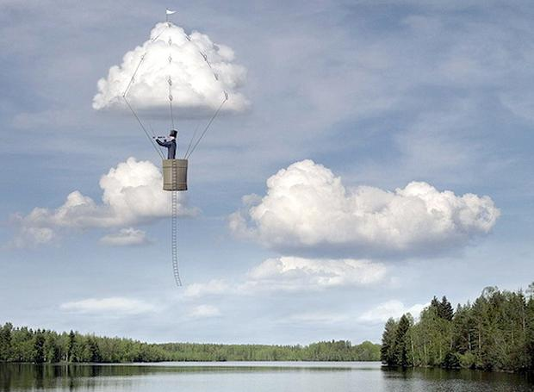
The best part of the creative process is…
Student 1: For me the best part of the creative process is the elaboration because is reassuring.

Slide 10

Student 2: Implementation, because I can see my work finished and I’m curious to compare it with the first ideas.
Notes:
<numero>

Slide 11

Student 3: For me, the best part of the creative process is the insight, because it is the most productive.
Big Bang!
Notes:
<numero>

Slide 12

Student 4: Elaboration because I like to make up my idea and change the creative process while I’m doing it
This represents that my idea changes while I'm doing it, e.g. from a grey sky to a sunny sky.
Notes:
<numero>

