Slide 1
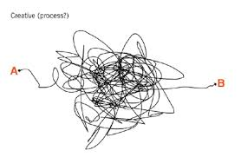
The creative process
Vocabulary
How to be creative
From the website: https://youtu.be/weIQIthC3Ks
CLIL Iprase 2021_Irene Leveghi
Vocabulary from Cambridge Dictionary

Slide 2
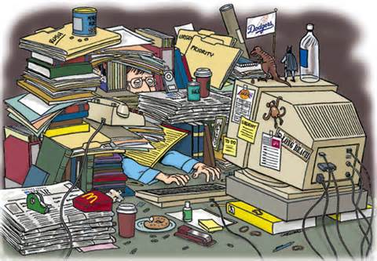
MESSY: dirty or untidy
I think creativity for the most part is a very __________ affair.

Slide 3
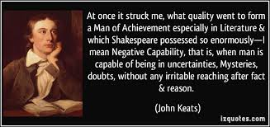
CAPABILITY: the ability or power to do something
One of the key elements, I think, is something that the English poet Jhon Keats called negative _______.

Slide 4
CHASE: to run after someone or something in order to catch them or it.
...this ability to stay in a space where you don’t exactly know what’s going to happen next, willing to ______ down ideas, and there are also willing to understand that not of all them are going to lead somewhere.

Slide 5
PURSUE: to try to do something over a period of time.
But the experience of _______ an idea will influence the next idea.

Slide 6
PROMPT: done or acting quickly and without waiting.
Each creative person, I think, develops his or her own tools and ______ for their creativity.

Slide 7
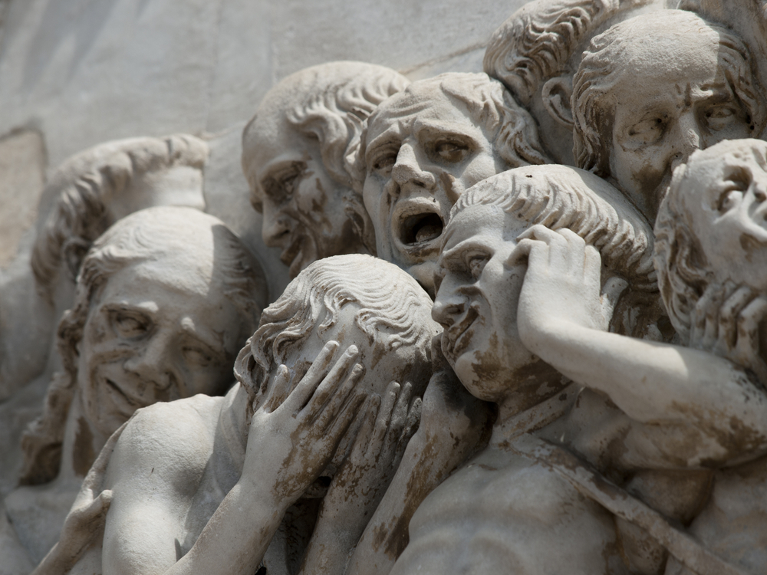
DESPAIR: a feeling of having no hope.
For me the challenging part is understanding it is a spiral of excitement and despair and to allow myself the _______, because it leads to new things.

Slide 8
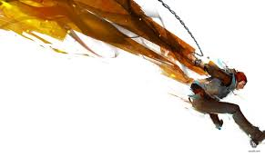
TO SPRING: to jump or move somewhere suddenly.
So that’s another piece of creativity that’s so essential is knowing that you have to keep at it, that is not going ______ full blown out your head.

Slide 9
THRESHOLD: the level or point at which you start to experience something, or at which something start to happen.
And then there’s another stage of illumination, where these connection automatically, subconscious collide and then reach the ______________ of consciousness.

Slide 10
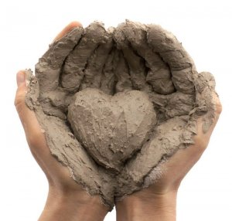
TO CRAFT: to make object, especially in a skilled way.
You think about your audience and you really ______ the message so it’s best received by people, because some of the greatest creative ideas of all time can easily be lost because they’re not packaged in the right way or not consumable.

Slide 11
NUANCED: made slightly different in appearance, meaning, sound.
And what interests me is we bring all this together to come up with a more ___________ model of creativity.

Slide 12
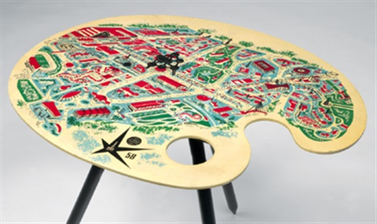
ENDEAVOR: an effort or attempt to do something.
So I think any ________ or any discipline that requires you to create something novel and new is going to benefit from collaboration.

Slide 13
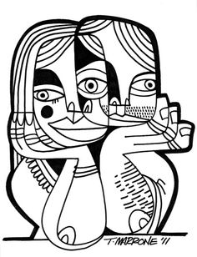
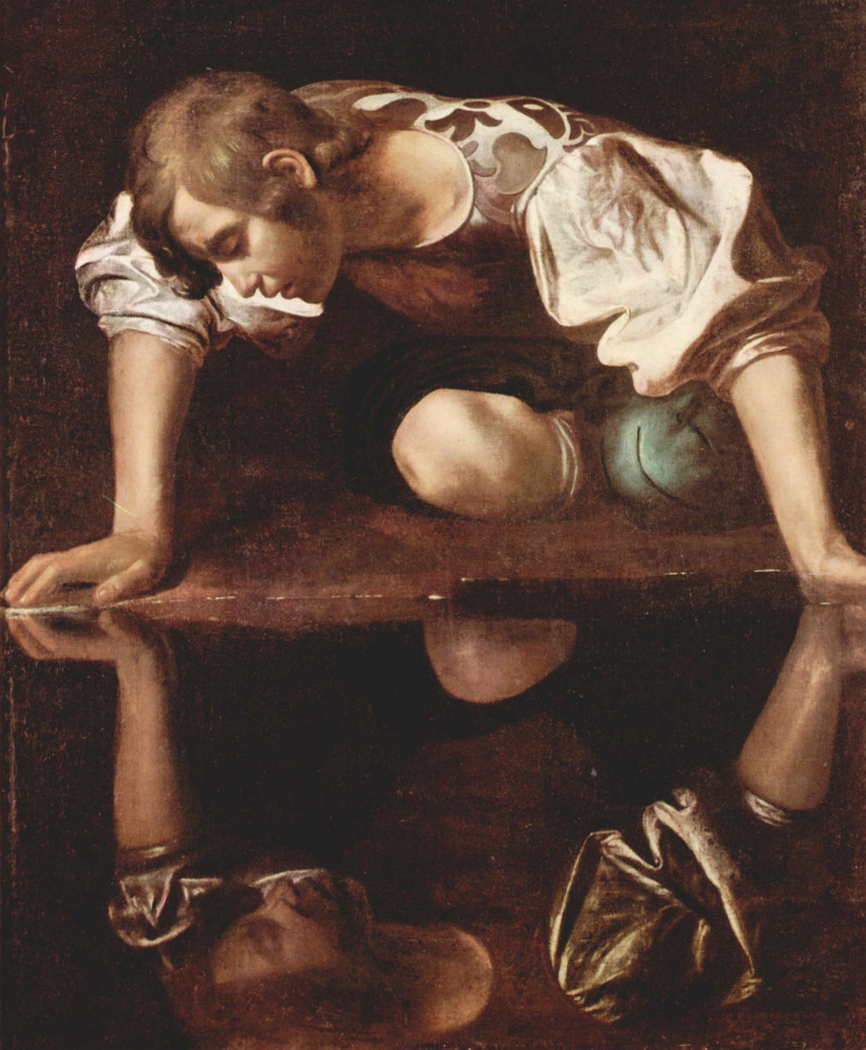
CARBON COPY: a person or thing that is very similar to or exactly like another person or thing.
If you’re working with someone who’s a ________ of yourself, you may as well be working alone.

Slide 14
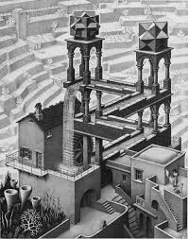
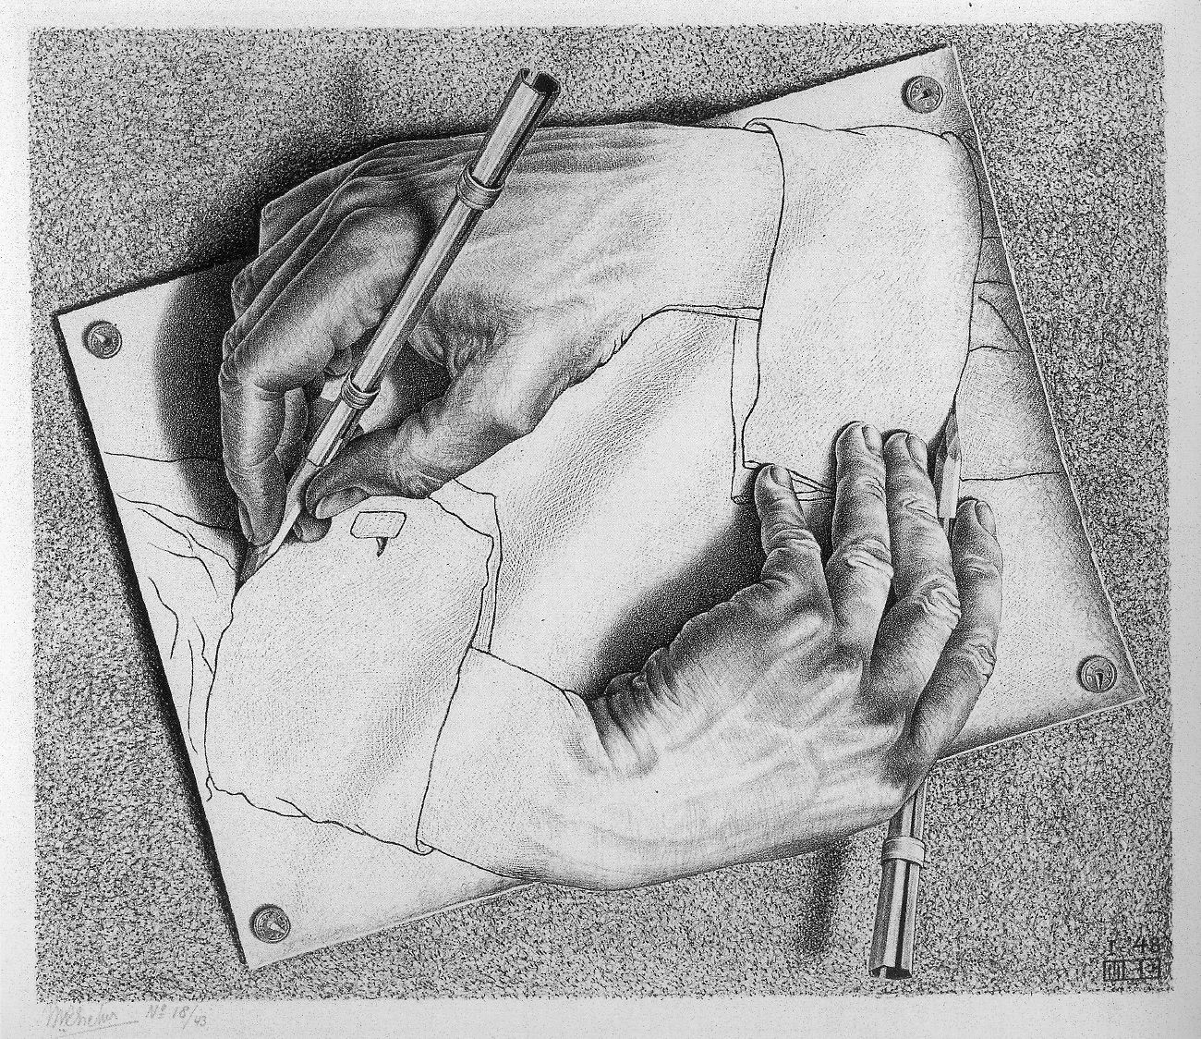
BLUE: unexpected, not predicted.
I think we have to let go of this notion of originality. We have this romantic notion that ideas kind of come out the ______

Slide 15
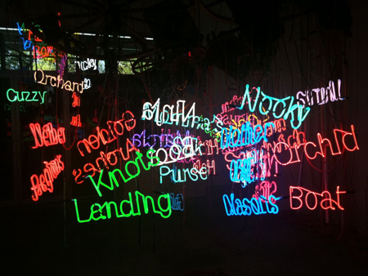
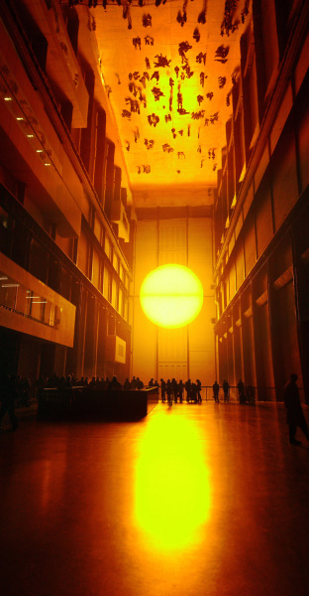
SPARK: a small amount of a quality or intense feeling.
Even though we have these _______ of insights, we have these flashes where we suddenly realize something, that doesn’t mean that that came from nowhere.

Slide 16
CATCH-ALL: general and intended to include everything.
Anyone can be creative in the domain that is best for them to express themselves. It’s important to think about creativity a little bit differently than just this _____________things.

