Slide 1
THE CREATIVE PROCESS
Irene Leveghi
Clil IPRASE 2020-2021
Slide 1

Slide 2
What is a “creative process”?
Ss think about a word related to the topic (they could also draw a picture or take an object) 5’
Brainstorm in pairs for 2 mins
Sharing
THE PROCESS BY WHICH THINGS ARE
CREATED FROM AN IDEA TO ITS REALISATION
What is the first step to create smt new?
TO BE GRADED
Slide 2

Slide 3
Slide 3

Slide 4
SO, WHAT IS CREATIVITY?
Ss answer in turn and without think too much - 2m
WHEN SOMETHING NEW AND VALUABLE IS CREATED
Slide 4

Slide 5
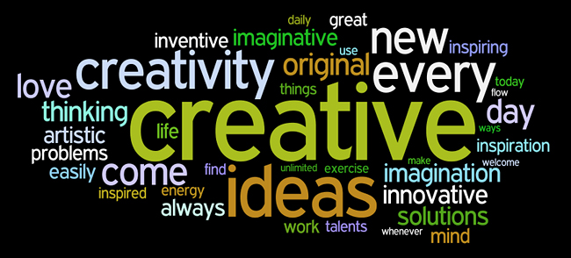
The process of producing something that is both original and worthwhile
Slide 5
From Google images

Slide 6
THE STEPS OR PHASES OF A CREATIVE PROCESS ARE FIVE
In your opinion: What is step 1 of the creative process?
From Google images
Slide 6

Slide 7
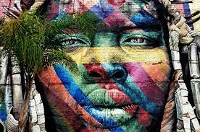
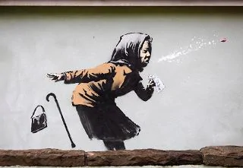
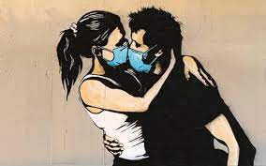
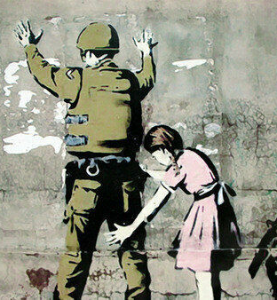
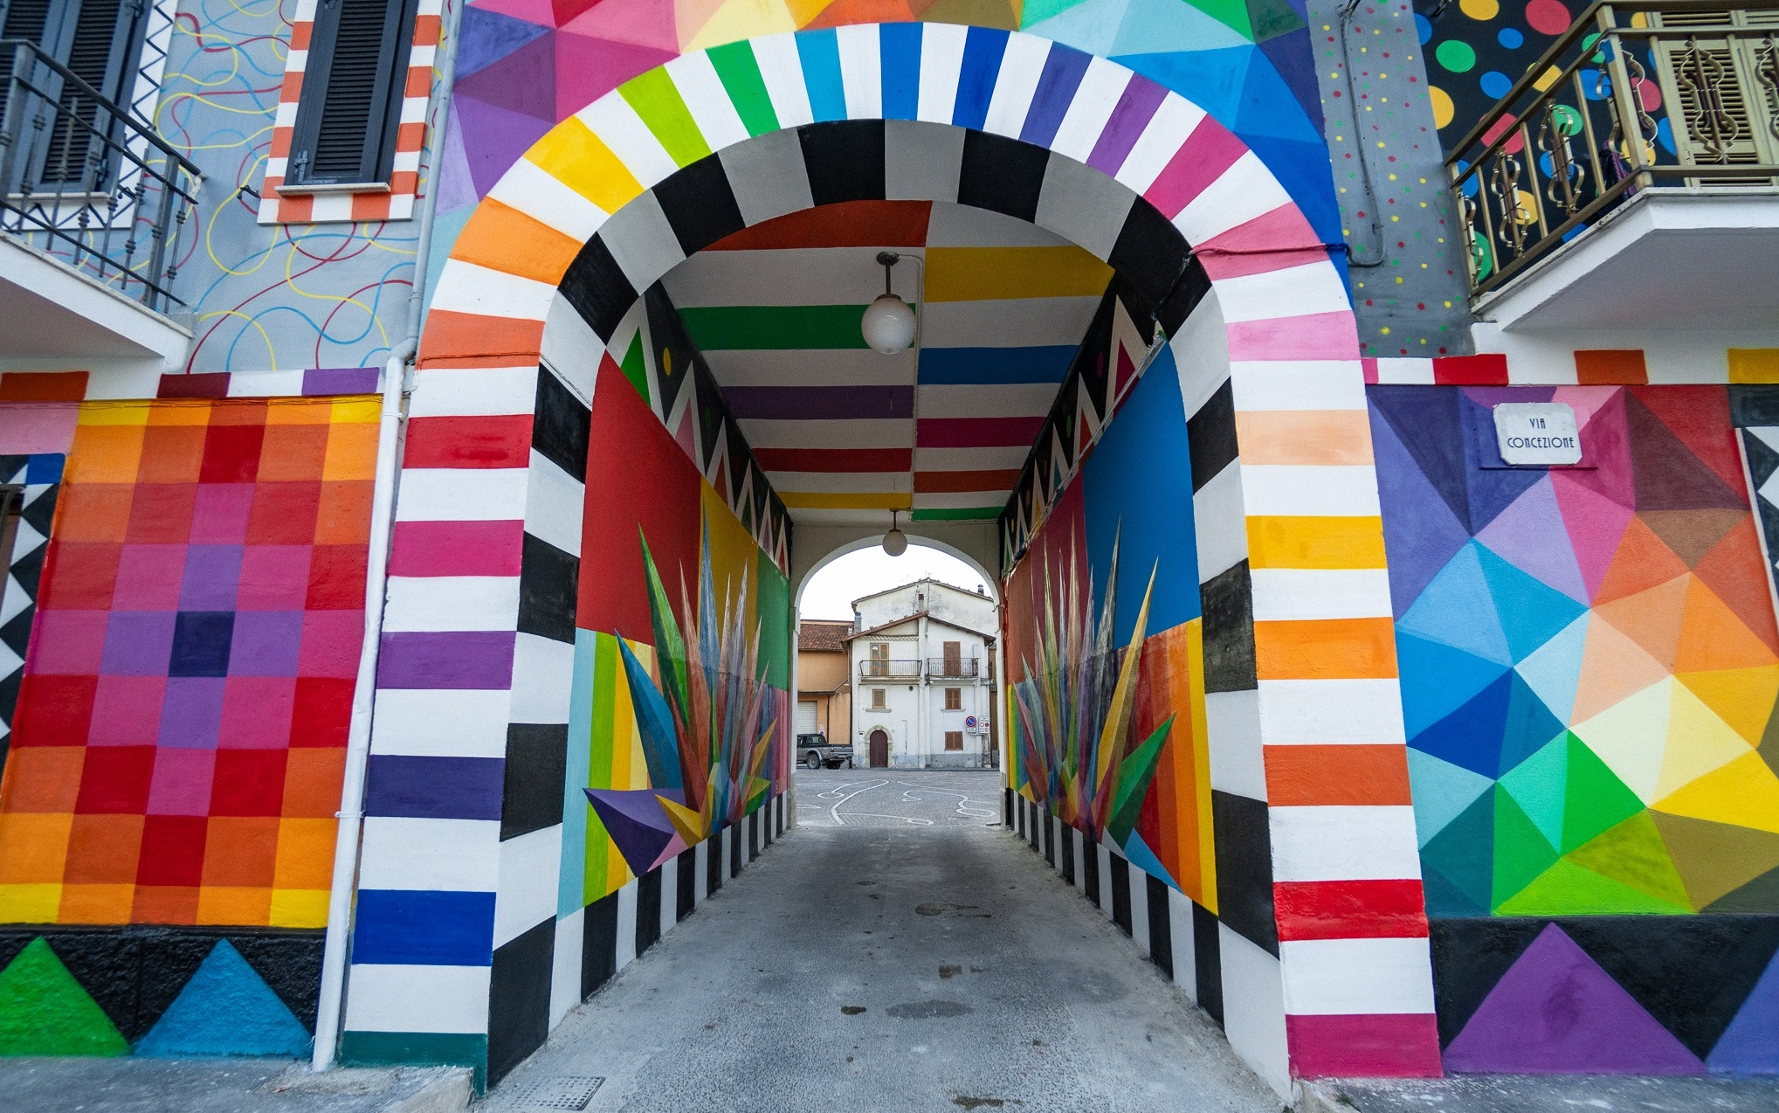
BRAINSTORMING...WHY? (1m to think…)
Came up with your idea
General plan for your work
Lists, Descriptions
Collect multiple images
Quick drawings and writings
Research
Reference images
From Google images
Slide 7

Slide 8
Slide 8 and 9 for the Activity n. 2 Ss have to complete the first step about the topic: Street Art
TOPIC/EVENT:
WORDS THAT RELATE:
DRAWINGS THAT RELATE:
Slide 8

Slide 9
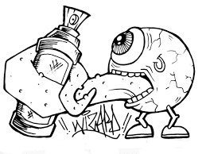
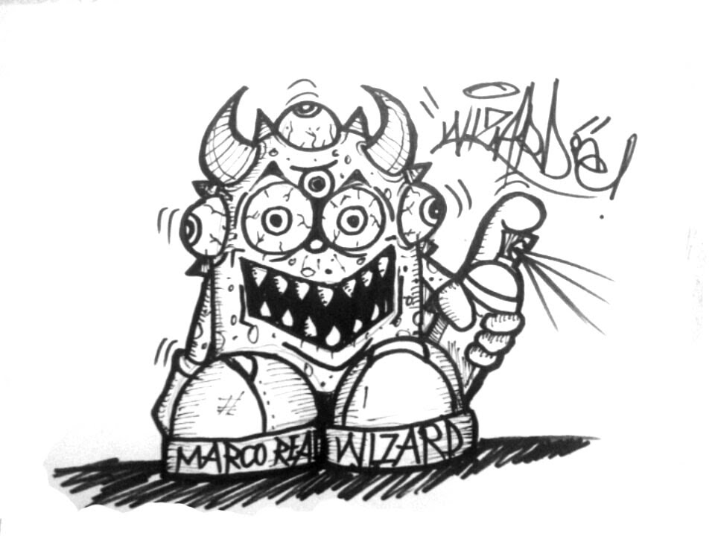
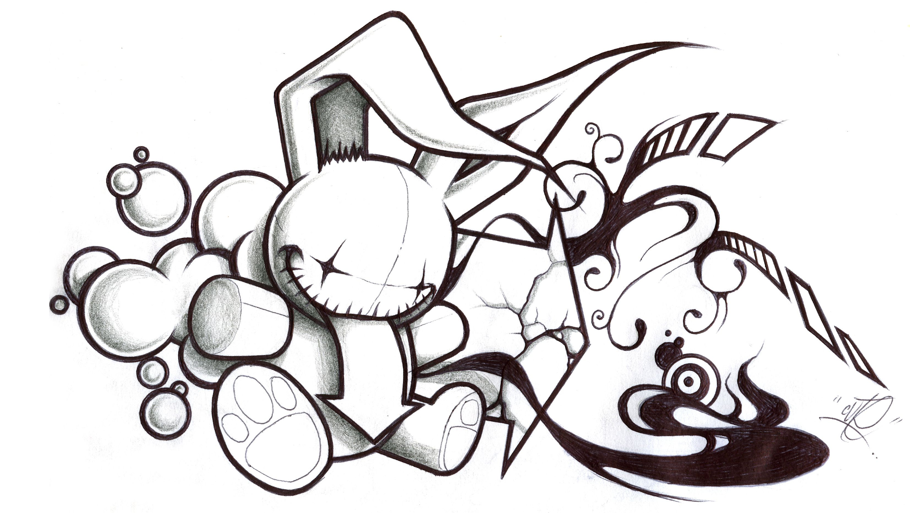
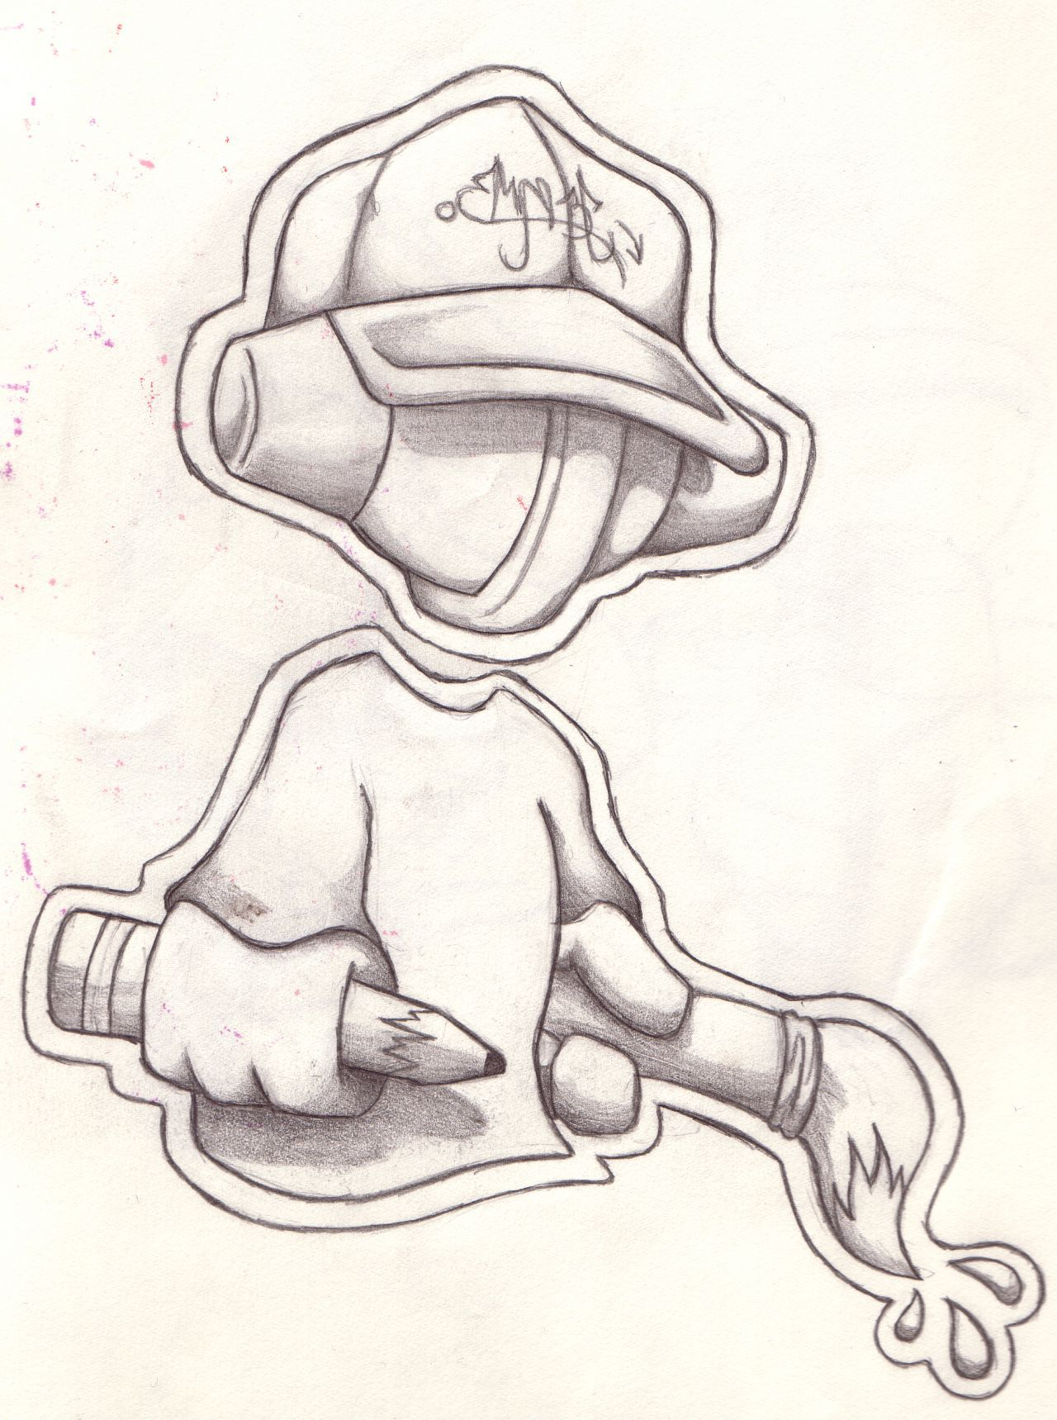
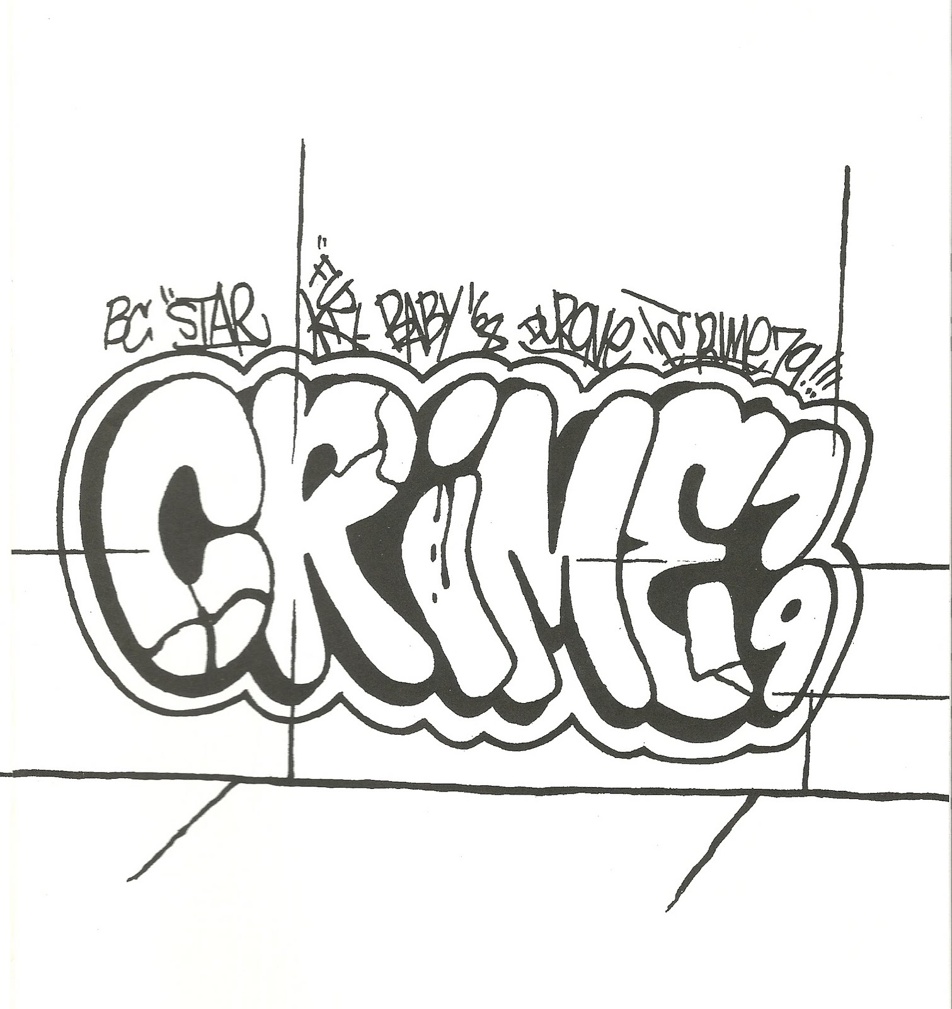
TOPIC / EVENT: Street Art
WORDS THAT RELATE:
tag roller legal walls
character wildstyle burner
piece illegal free walls
letters crew piece
culture risk underground
throw up spray words
Slide 9

Slide 10
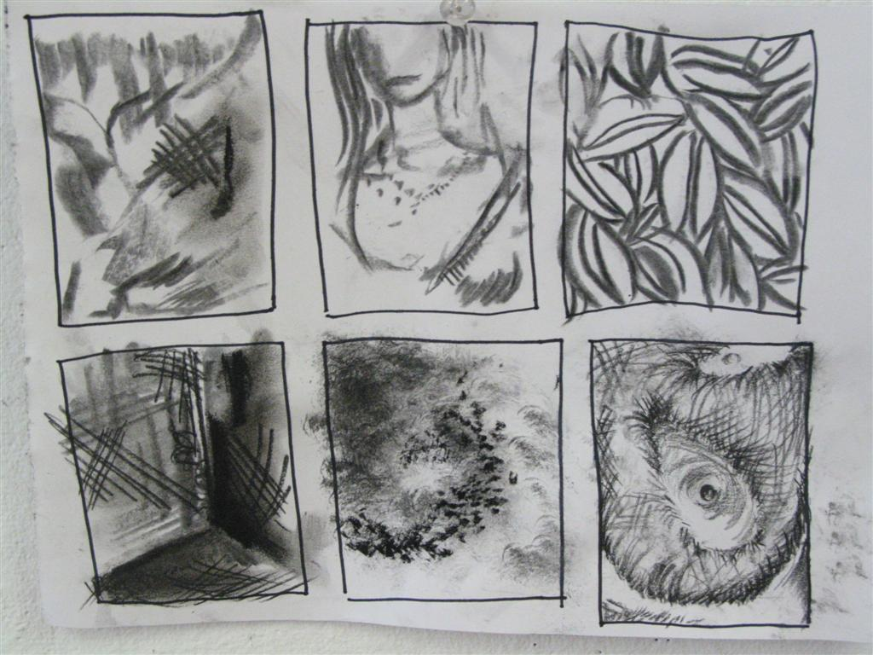
WHAT IS THE STEP 2? 2m to think
THUMBNAIL SKETCHES
multiple possibilities
small quick drawings
you plan out a variety of
possible COMPOSITIONS
What does it mean:
COMPOSITION ? (2m)
From Google images
The arrangement, layout and/or use of space
Slide 10

Slide 11
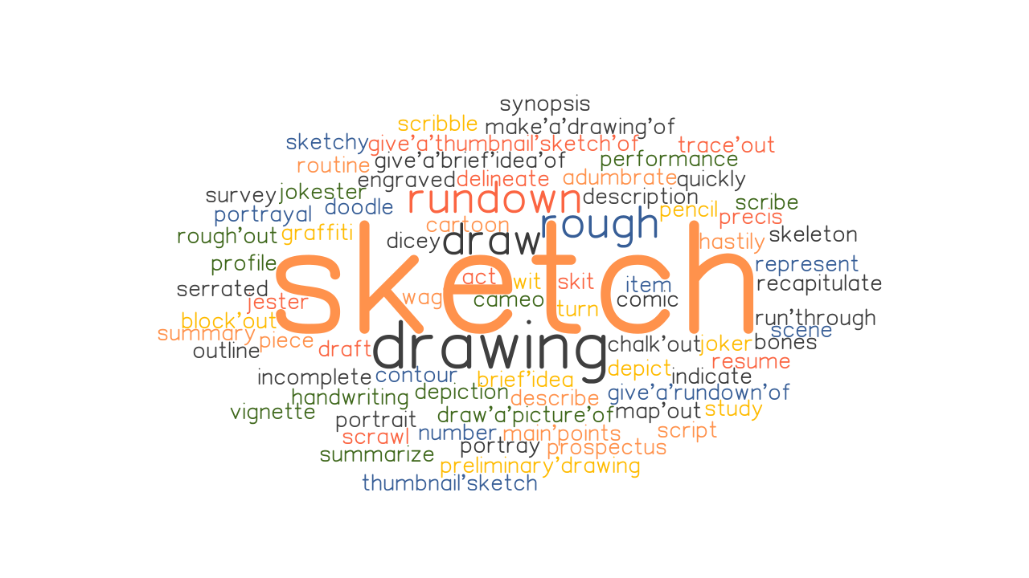
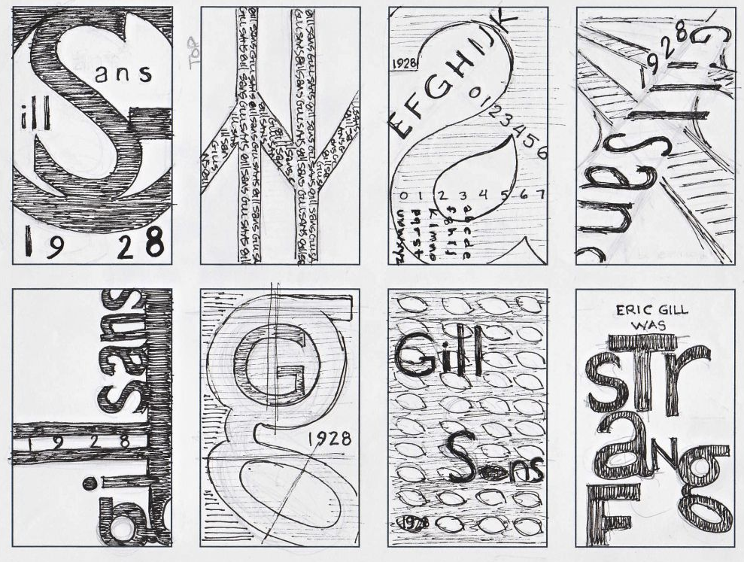
THUMBNAIL SKETCHES example LOT OF POSSIBLE LAYOUTS
Which thumbnail sketch do YOU think has the best design, concept and composition?
Discussion 5m
From Google images
Slide 11

Slide 12
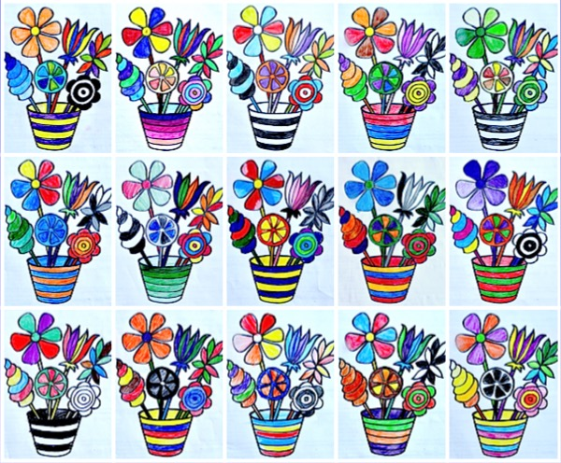
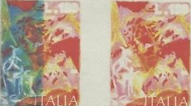
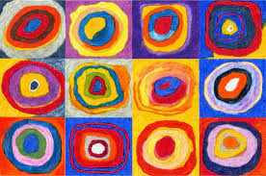
3° STAGE: COMPREHENSIVE and media practice
What it could mean? 2m
SMALL, ROUGH VERSION OF YOUR FINAL
DECIDE ON:
COLORS
TEXTURES
TECHNIQUES
TO AIM YOUR FINAL WORK
Slide 12
From Google images

Slide 13
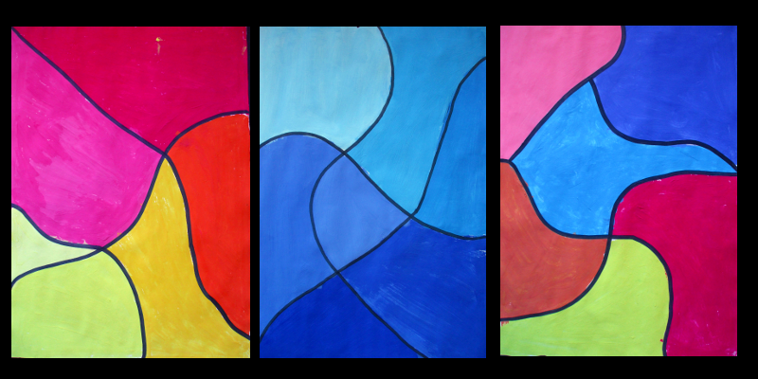
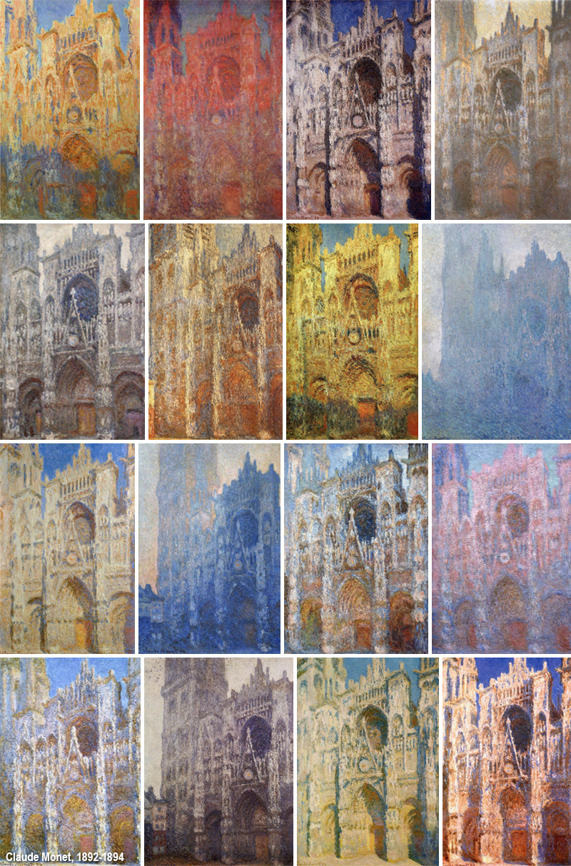
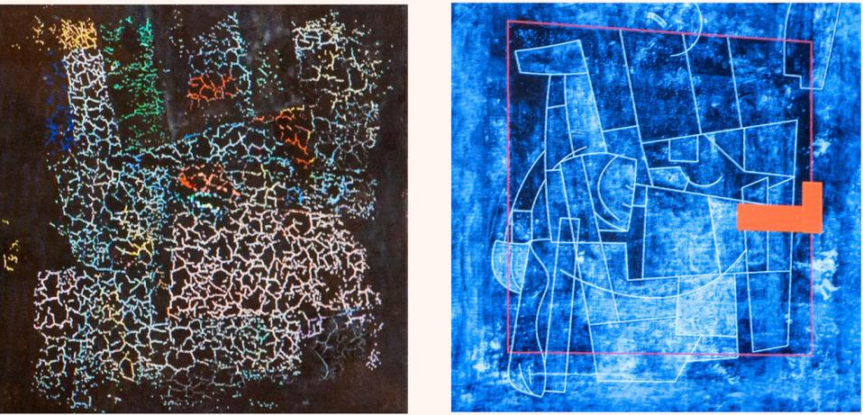
Which color combination do YOU think works better?
2m
Slide 13

Slide 14
4. FINAL ARTWORK
An excellent CRAFTMANSHIP
COMPOSITION
+
COLOR
+
TECHNIQUES
Slide 14

Slide 15
5. REFLECTION / EVALUATION
AT THE END OF YOUR WORK:
GROUP CRITIQUE AND/OR INDIVIDUAL WRITTEN REFLECTION
Slide 15

Slide 16
Slide 16 for the Activity n. 3
GROUP EXERCISE
put in order the steps of a project
and discuss
REFLECTION/
EVALUATION
COMPREHENSIVE
THUMBNAIL
SKETCHES
BRAINSTORMING/
RESEARCH
FINAL ARTWORK
Slide 16

