Slide 1
U3_L2_ALL6
Effects of Viscosity
Class: 5 CM/TL Prof. Massimo Eccher
School year: 2017-18

Slide 2
Summary
Viscous flows
Laminar vs turbulent flows
Reynolds number
Flow separation
Airfoil stall

Slide 3
REAL EFFECTS: VISCOSITY (μ)
To understand drag and actual airfoil/wing behavior we need an understanding of viscous flows.
Inviscid (frictionless) flow around a body will result in zero drag!
Do all real flows have friction?

Slide 4
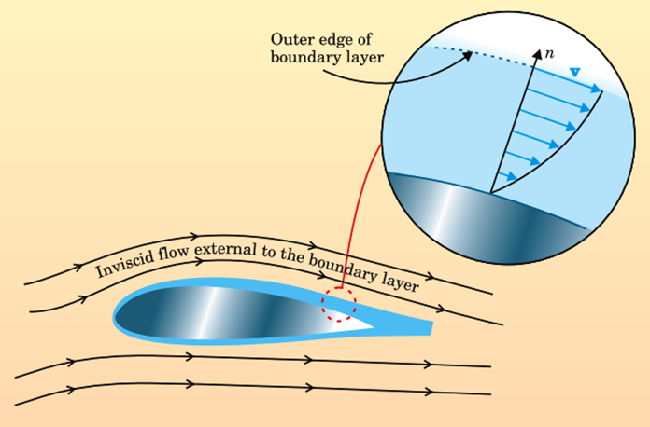
BOUNDARY LAYER
Flow adheres to surface because of friction between gas and solid boundary. Thin region of retarded flow in vicinity of surface, called a ‘Boundary Layer’
At outer edge of B.L., V∞
At solid boundary, V=0
Source: https://leehamnews.com/2018/01/05/bjorns-corner-aircraft-drag-reduction-part-11/

Slide 5
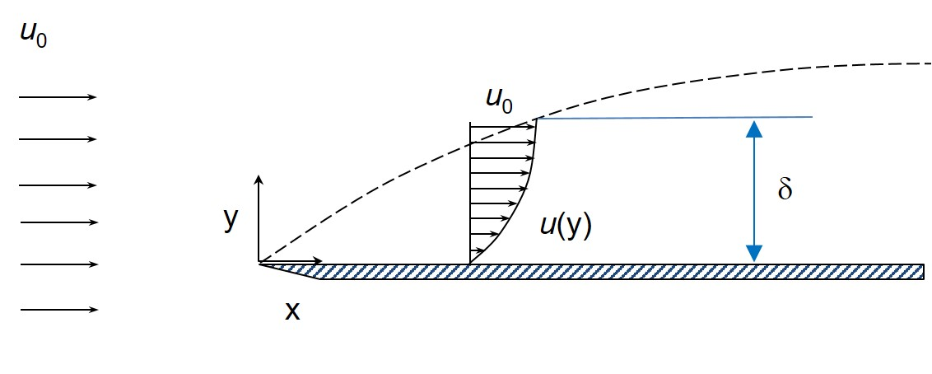
COMMENTS ON VISCOUS FLOWS
Outer edge of boundary layer
Boundary layer
Surface
Velocity profile through a boundary layer
https://en.wikipedia.org/wiki/Boundary_layer_thickness

Slide 6
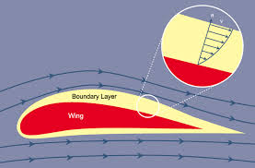
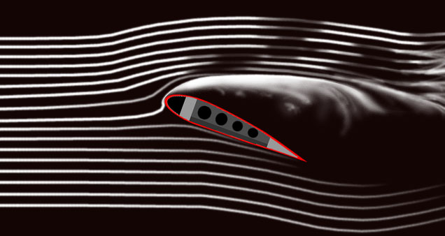
TYPES OF FLOWS: FRICTION VS. NO-FRICTION
http://www.zoombd24.com/boundary-layer-control-airfoil-boundary-layer-separation-control-devices-details
Flow very close to surface of airfoil is
Influenced by friction and is viscous
(boundary layer flow)
Stall (separation) is a viscous phenomena
Flow away from airfoil is not influenced
by friction and is wholly inviscid
https://people.rit.edu/pnveme/MECE409/Images/FlowClassification.html

Slide 7
Two types of viscous flows
Laminar: streamlines are smooth and regular and a fluid element moves smoothly along a streamline
Turbulent: streamlines break up and fluid elements move in a random, irregular, and chaotic fashion
Turbulence
Transition
Laminar flow
https://www.quora.com/Which-is-better-in-a-heat-transfer-laminar-flow-or-turbulent-flow

Slide 8
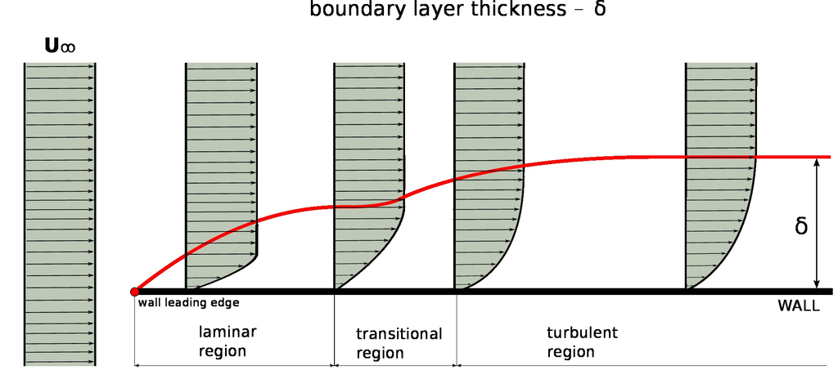
LAMINAR VERSUS TURBULENT FLOW
All B.L.’s transition from laminar to turbulent
https://www.cfdsupport.com/OpenFOAM-Training-by-CFD-Support/node279.html
Turbulent velocity profiles are ‘fuller’
Notes:
Dopo la prima parte dell impatto, il flusso diventa turbolento
Il boundary layer turbolento è piu spesso (delta turb)

Slide 9
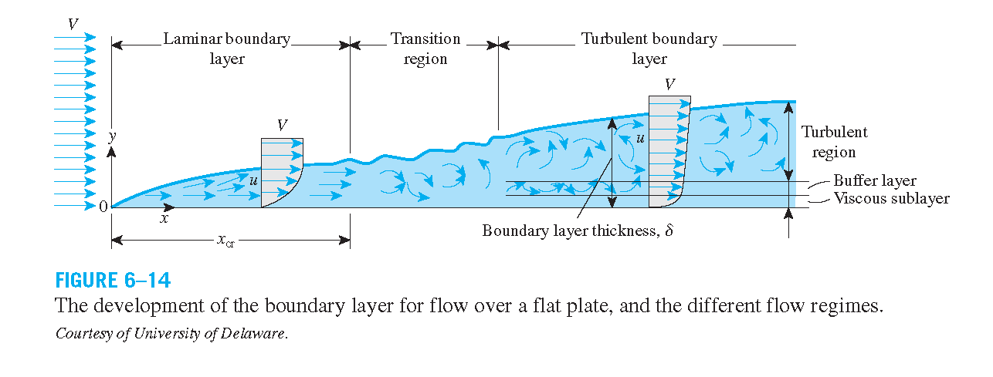
Velocity boundary layer development on a flat plate.
https://physics.stackexchange.com/questions/281281/about-the-definition-of-boundary-layer

Slide 10
LAMINAR VERSUS TURBULENT FLOW
Boundary layers can be either laminar or turbulent.
A reasonable assessment of whether the boundary layer will be laminar or turbulent can be made by calculating the Reynolds number of the local flow conditions.

Slide 11
THE REYNOLDS NUMBER, Re
Reynolds number is ratio of two forces:
Inertial Forces
Viscous Forces
l is length scale (chord)
Reynolds number tells you when viscous forces are important and when viscosity may be neglected
Outside B.L. flow
Inviscid (high Re)
Within B.L. flow
highly viscous
(low Re)
http://www.zoombd24.com/boundary-layer-control-airfoil-boundary-layer-separation-control-devices-details

Slide 12
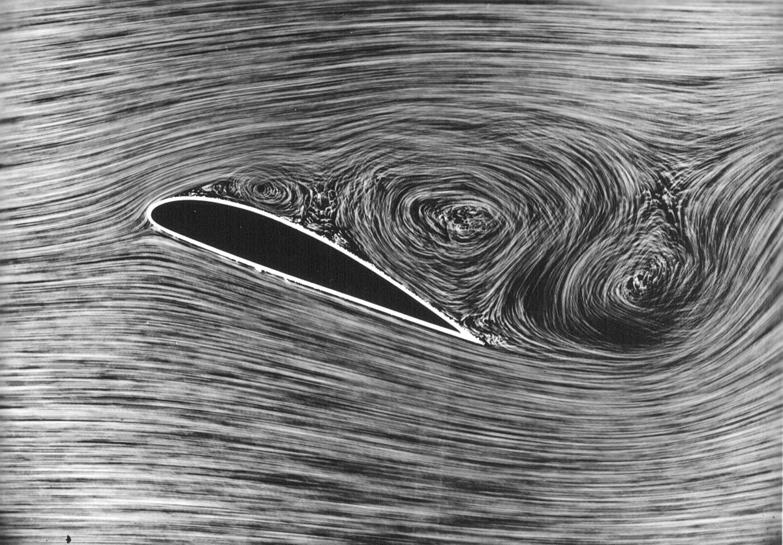
What causes flow separation?
https://en.wikipedia.org/wiki/Flow_separation

Slide 13
FLOW SEPARATION
Friction causes flow separation within boundary layer
Separation then creates another form of drag called pressure drag due to separation
https://en.wikipedia.org/wiki/Flow_separation

Slide 14
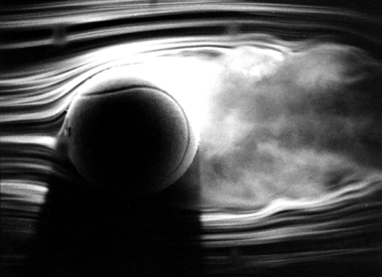
COMPARISON OF DRAG FORCES
d
d
Same total drag as airfoil
http://www.aerospaceweb.org/question/aerodynamics/q0215.shtml

Slide 15
OVERVIEW: AIRFOIL STALL
Friction causes flow separation within boundary layer
B.L. either laminar or turbulent
All laminar B.L. → turbulent B.L.
Turbulent B.L. ‘fuller’ than laminar B.L., more resistant to separation
Separation creates another form of drag called pressure drag due to separation
Dramatic loss of lift and increase in drag
https://commons.wikimedia.org/wiki/File:1915ca_abger_fluegel_(cropped_and_mirrored).jpg

Slide 16
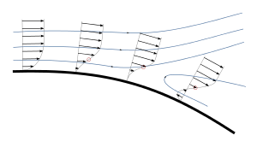
WHY DOES BOUNDARY LAYER SEPARATE?
Flow separation occurs when the BL travels far enough against an adverse pressure gradient that the speed of the BL relative to the object falls almost to zero.
The fluid flow becomes detached from the surface of the object, and instead takes the forms of eddies and vortices.
Graphical representation of the velocity profile in the boundary layer.
https://commons.wikimedia.org/wiki/File:Boundary_layer_separation.svg

Slide 17
Airflow separating from a wing at a high angle of attack

Slide 18
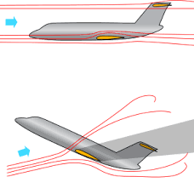
Why does an airfoil stall?
https://en.wikipedia.org/wiki/Stall_(fluid_mechanics)

Slide 19
WHY DOES AN AIRFOIL STALL?
Two undesirable consequences of separated flow over airfoil
Dramatic loss of lift (stalling)
Separated flow causes higher pressure on upper surface of airfoil
Major increase in drag
Separation causes lower pressure on trailing edge
Unbalance of pressure force causes pressure drag due to separation

Slide 20
Inclination effects
https://www.grc.nasa.gov/www/k-12/airplane/incline.html

Slide 21
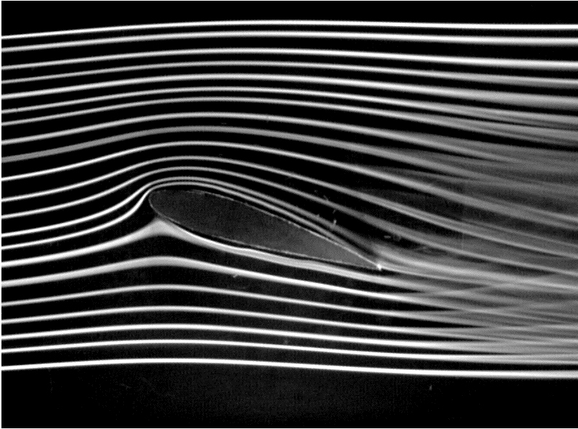
SAMPLE DATA: CAMBERED AIRFOIL STALL
https://answers.unity.com/questions/910684/how-to-create-interactive-fluid-effect.html
Lift or Lift Coefficient
https://en.wikipedia.org/wiki/Flow_separation
Angle of Attack, 

