Slide 1
U3_L1_ALL2
Aerodynamics and Airfoils
Class: 5 CM/TL Prof. Massimo Eccher
School year: 2017-18

Slide 2
WINGS and AIRFOILS
Adapted from: http://www.aerospaceweb.org/question/design/q0101.shtml
An airfoil is the shape of a wing.
An airfoil-shaped body moved through a fluid produces an aerodynamic force.

Slide 3
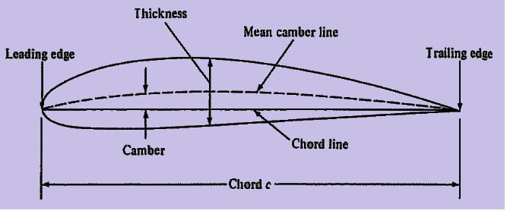
HELP ME with AIRFOIL TERMINOLOGY
Adapted from: http://www.aerospaceweb.org/question/design/q0101.shtml
Mean Chamber Line: Set of points halfway between ….. and ……surfaces
measured perpendicular to mean chamber line itself
Leading Edge: Most forward point of mean …..
Trailing Edge: Most reward point of mean …….
Chord Line: Straight line connecting …….
Chord, c: Distance along the chord line ….. to trailing edge
Camber: ……. distance between ……line and …… line
measured perpendicular to chord line

Slide 4
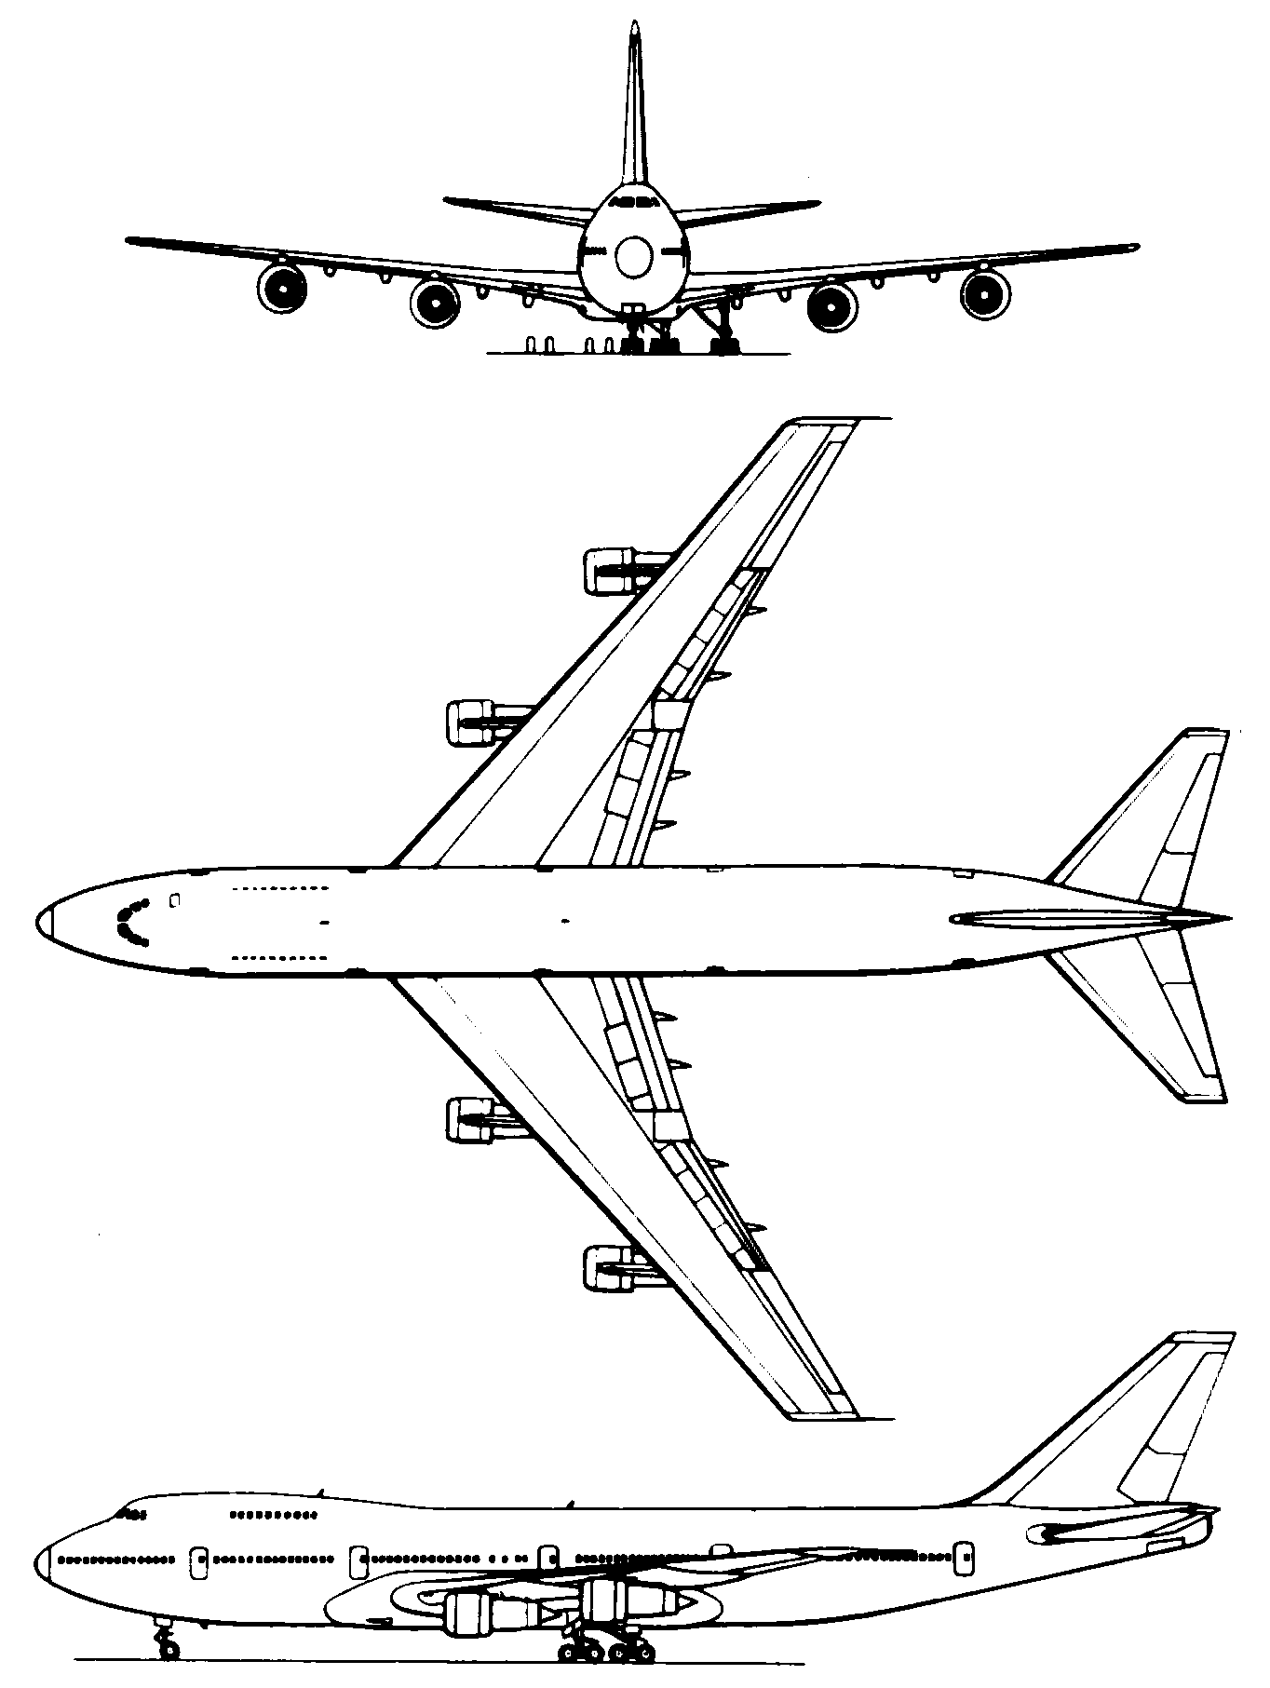
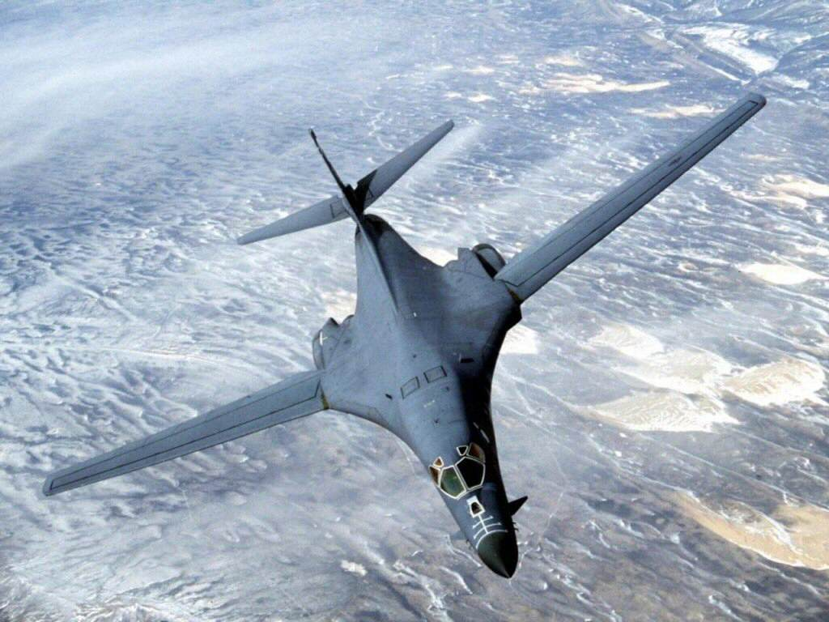
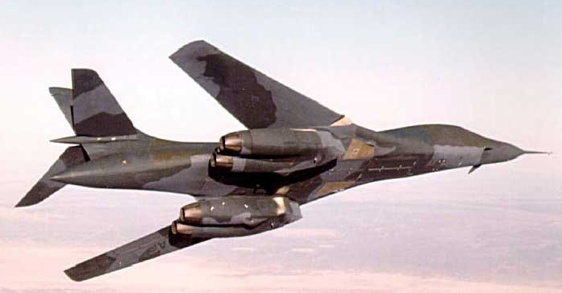
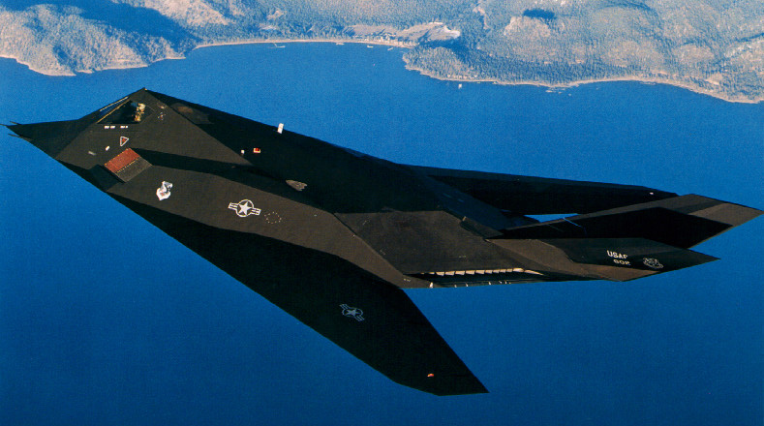
“Tell me everything can you about the design of these wings…”
δ
dihedral
All images are licensed under BY Creative Commons.

Slide 5
THE AERODYNAMIC FORCE ON A WING
Relative Wind: Direction of V∞
We used subscript ∞ to indicate far upstream conditions
Angle of Attack, α, Angle between relative wind (V∞) and chord line
Total aerodynamic force, R, can be resolved into two force components
Lift, L: Component of aerodynamic force perpendicular to relative wind
Drag, D: Component of aerodynamic force parallel to relative wind
https://aviation.stackexchange.com/questions/28019/what-factors-determine-the-direction-of-the-resultant-force-vector

Slide 6
RESOLVING THE AERODYNAMIC FORCE: ROCKET
Aerodynamic force, R, may also be resolved into components perpendicular and parallel to chord line
Normal Force, N: Perpendicular to chord line
Axial Force, A: Parallel to chord line
L and D are easily related to N and A
For airfoils and wings, L and D most common
For rockets, missiles, bullets, etc. N and A more useful
$$\begin{matrix}L=N\text{cos}α−A\text{sin}α \\ D=N\text{sin}α+A\text{cos}α\end{matrix}$$
https://aviation.stackexchange.com/questions/28019/what-factors-determine-the-direction-of-the-resultant-force-vector

Slide 7
VARIATION OF L, D, AND M WITH α
Lift, Drag and M on a airfoil or wing will change as α changes
Variations of these quantities are some of most important information that an airplane designer needs to know
Aerodynamic Center
Point about which moments essentially do not vary with α
M_{ac}=constant (independent of α)
For low speed airfoils aerodynamic center is near quarter-chord point

Slide 8
SAMPLE DATA: SYMMETRIC AIRFOIL
Lift Coefficient
Adapted from: https://www.quora.com/How-is-lift-generated-with-symmetrical-wings
Angle of Attack, α
A symmetric airfoil generates zero lift at zero α

Slide 9
SAMPLE DATA: CAMBERED AIRFOIL
Lift Coefficient
Adapted from: https://www.quora.com/How-is-lift-generated-with-symmetrical-wings
Angle of Attack, α
A cambered airfoil generates positive lift at zero α

Slide 10
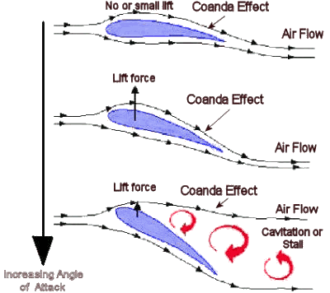
WHY DOES LIFT CURVE BEND OVER?
NO LIFT
FLIGHT
STALL
Source: http://www.formula1-dictionary.net/coanda_effect.html

