Slide 1
U1_L4_ALL5
METEOROLOGY
Class: 5 CM/TL Prof. Massimo Eccher
School year: 2017-18

Slide 2
All included images have been downloaded by the author from freely-available Internet sources.

Slide 3
Glossary for Weather
• sunny
• cloudy
• snowy
• rainy
• windy
• foggy
• boiling (very hot)
• hot
• warm
• not very warm
• cold / chilly
• freezing /icy (very cold)
• wet/humid
• dry

Slide 4
Glossary for Weather
There is a…
• gentle breeze
• wind
• strong wind
• tornado
• hurricane
There is a …..
• drizzle
• heavy rain
• storm
• thunderstorm

Slide 5
Weather phenomena
The weather in action is divided into the following categories of phenomena:
dew
fog
frost
clouds
precipitation
storms
optical effects

Slide 6
Weather phenomena
• Dew, fog and frost all result from ….
• Clouds form when …
• Precipitation includes the most common types of precipitation: rain …
• Storms cover the most extreme and destructive weather phenomena, such as …….
• Optical effects are atmospheric phenomena rather than ….

Slide 7
What affects climate?
There are many different factors that affect climate around the world. The most common are:
• Distance from the sea (Continentality)
• Ocean currents
• Direction of winds
• Shape of the land (“relief” or “topography”)
• Distance from the equator (latitude)
• Altitude
• Human influence

Slide 8
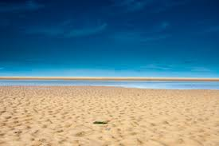
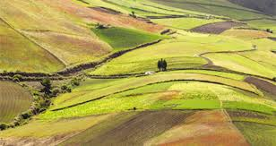
Distance from the sea (Continentality)
The sea affects the climate of a place. Coastal areas are cooler and wetter than inland areas.
Sea heats up …. And cools down ….
BY Creative Commons licensed images
Land heats up …. And cools down ….

Slide 9
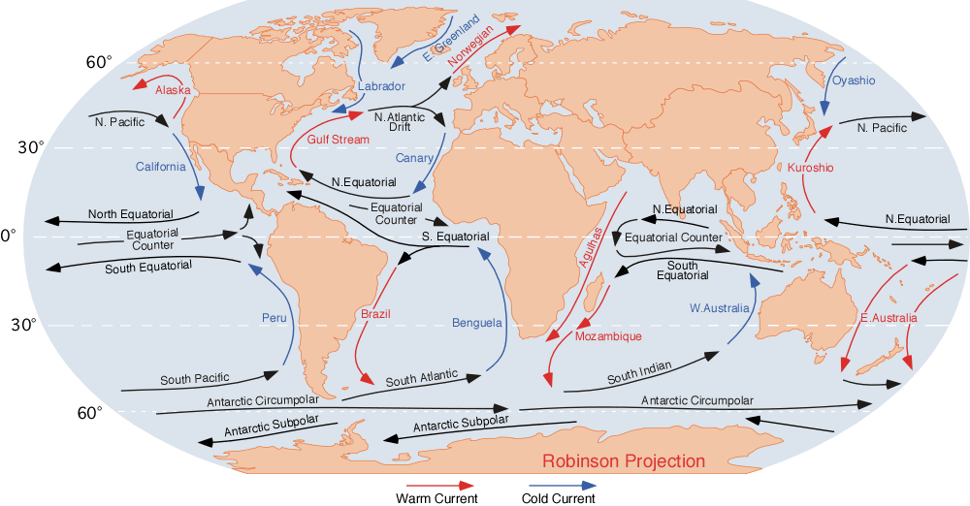
Weather vs. Climate
The diagram shows….
Ocean currents can increase or reduce temperatures.
https://en.wikipedia.org/wiki/Ocean_current#/media/File:Corrientes-oceanicas.png

Slide 10
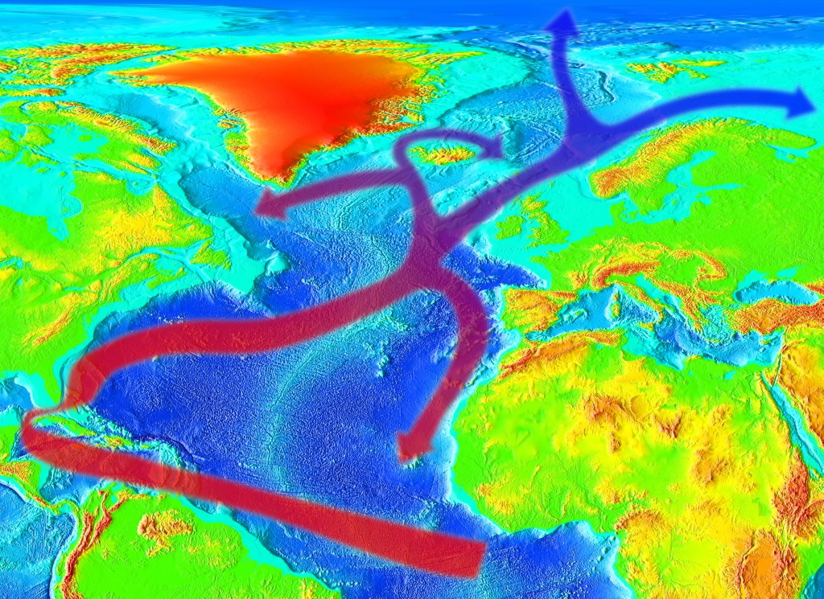
Gulf Stream
The diagram shows….
The Gulf Stream is a warm ocean current in the North Atlantic flowing from the Gulf of Mexico to the British Isles.
https://commons.wikimedia.org/wiki/Gulf_Stream#/media/File:Golfstream.jpg

Slide 11
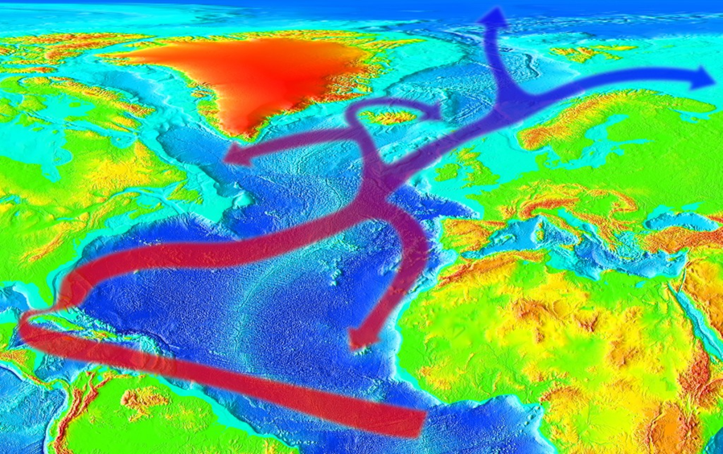
Gulf Stream
• The Gulf of Mexico has higher air temperatures than….as it is closer to the...
• So the air coming from the Gulf of Mexico to Britain is …
• The Gulf Stream keeps the west coast of …. free from … in the winter and, in the summer, …….. than other places of a similar latitude.
https://commons.wikimedia.org/wiki/Gulf_Stream#/media/File:Golfstream.jpg

Slide 12
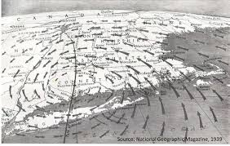
Direction of winds
Winds blowing from the sea often bring rain to the coast because…
Winds can also bring dry weather to inland areas because…..
Adapted from Creative Commons material.

Slide 13
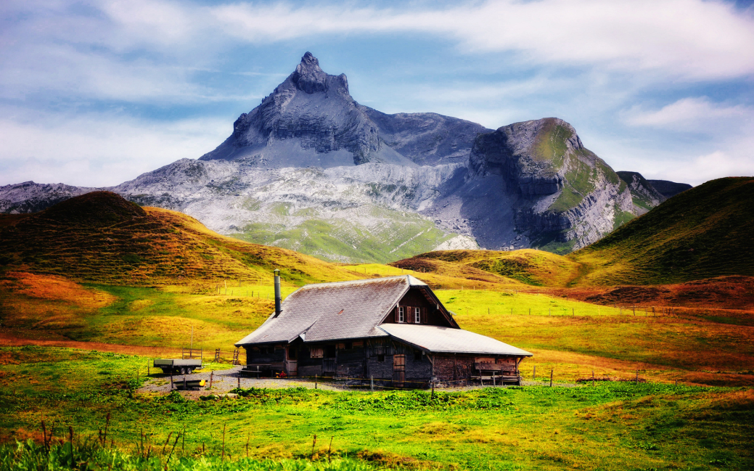
The shape of the land
Mountains can affect the climate of nearby lands. In some areas, mountains block …, so that one side of a mountain range may be ….. and the other side may be a desert.
Creative Commons licensed.

Slide 14
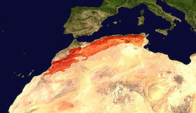
The shape of the land
MOROCCO, ATLAS MOUNTAIN act as ….
Creative Commons licence.

Slide 15
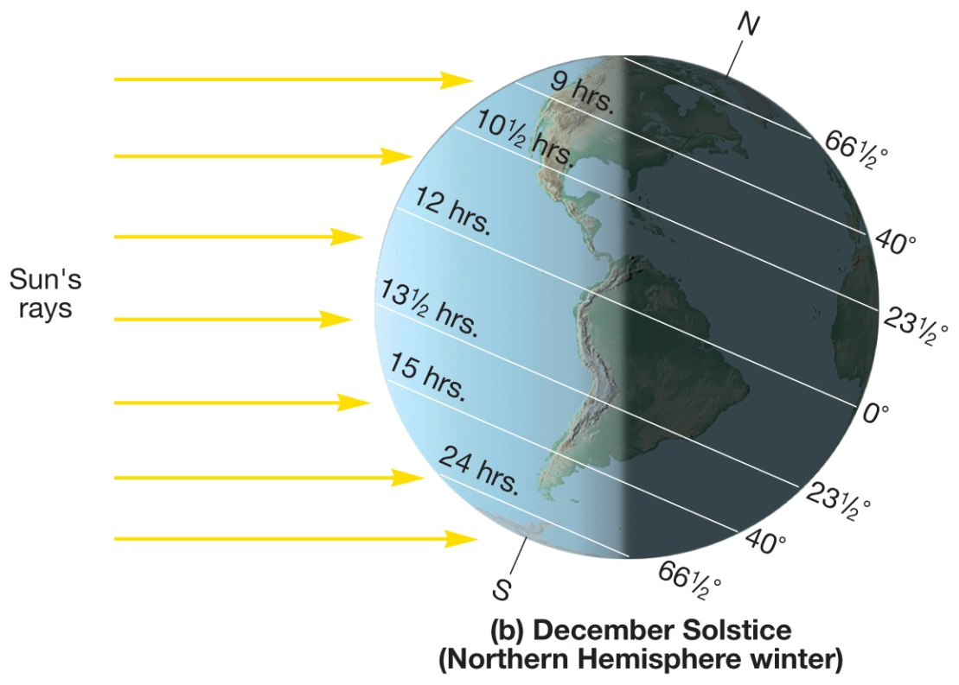
Latitude
The Latitude affect the …..
The climate becomes colder further from the … and closer to the …..
http://www.richhoffmanclass.com/chapter2.html

Slide 16
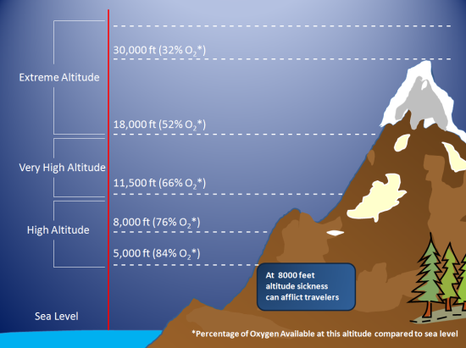
Altitude
Altitude is the height above sea level.
The higher the place is above…the colder it is.
Air temperature diminishes by about … every …. meters above sea level
https://oxygenlabs.wordpress.com/science/

Slide 17
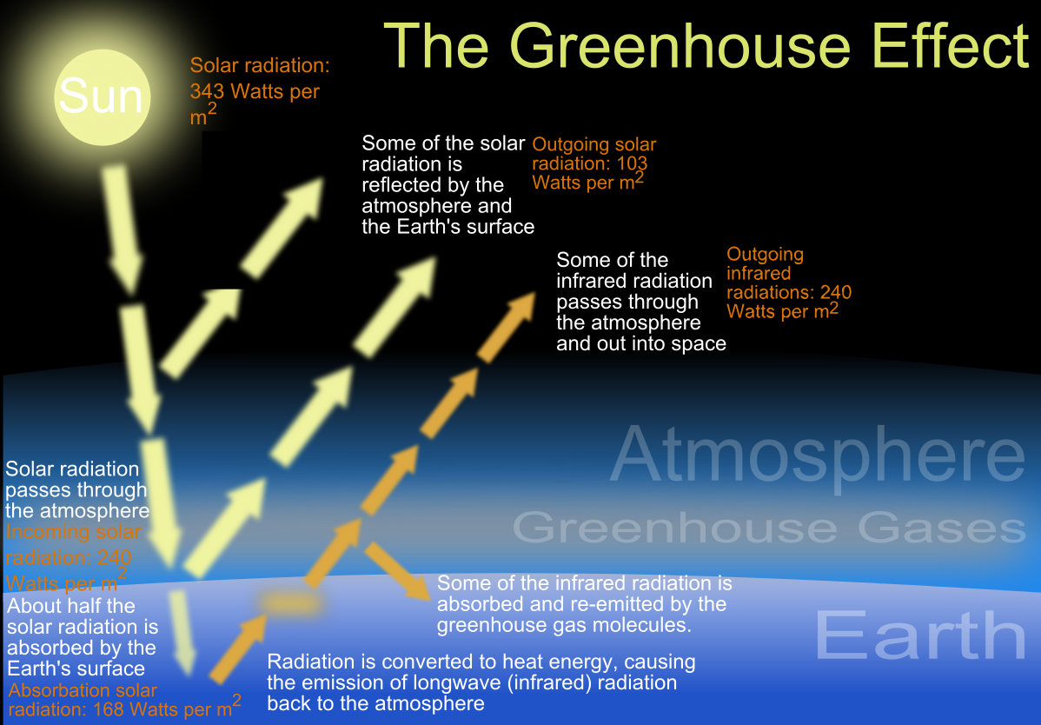
Human Activities
https://en.wikipedia.org/wiki/Greenhouse_effect#/media/File:The_green_house_effect.svg

