Slide 1
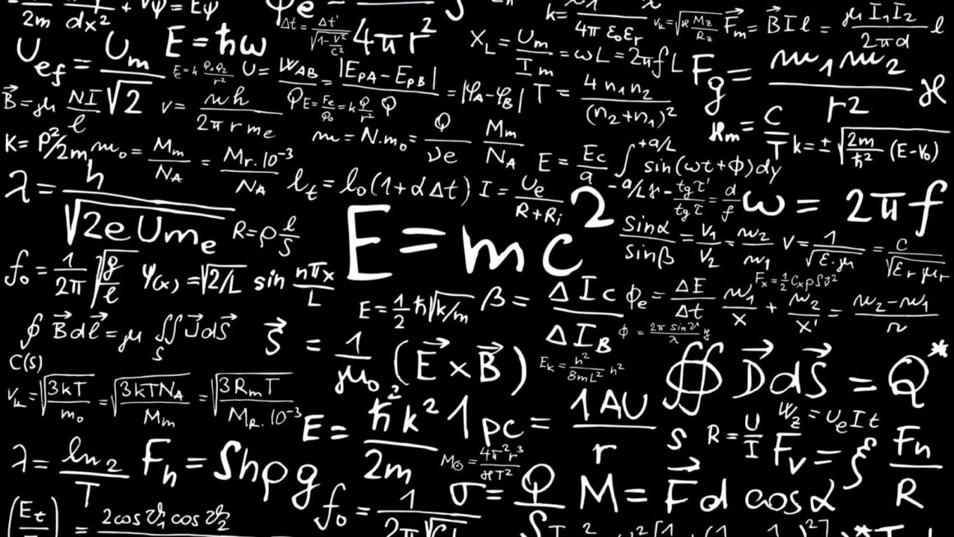
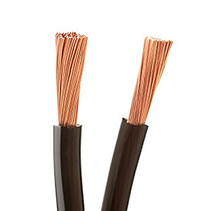
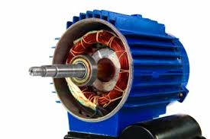
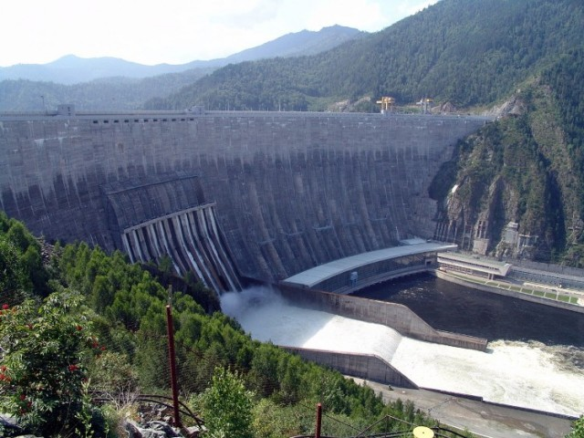
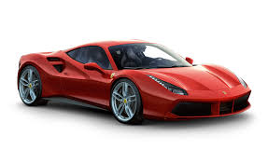
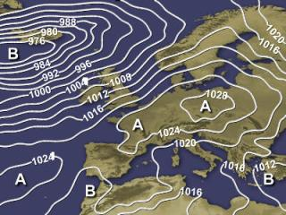
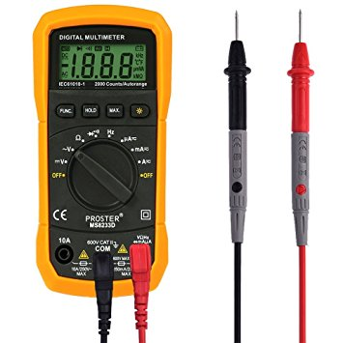
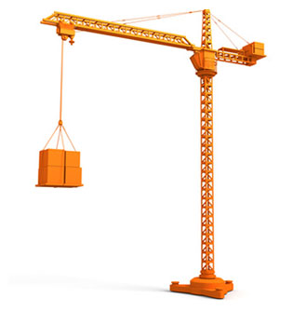
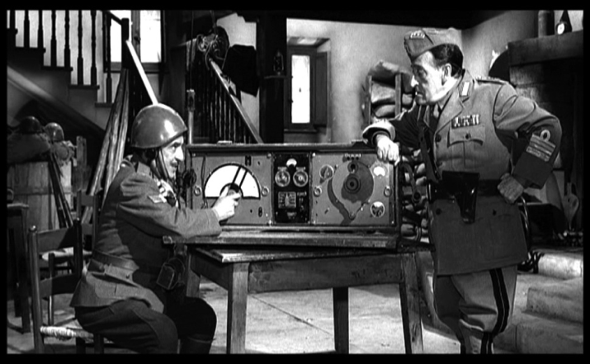
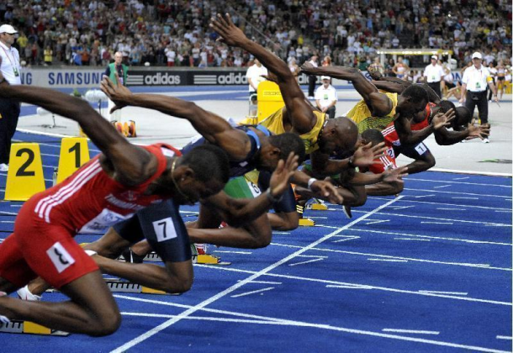
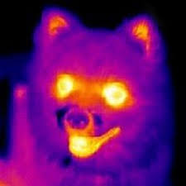
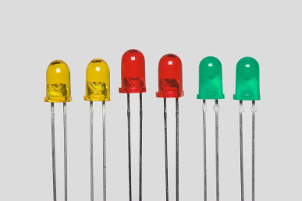
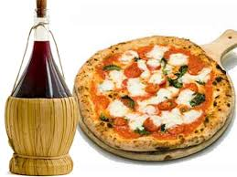
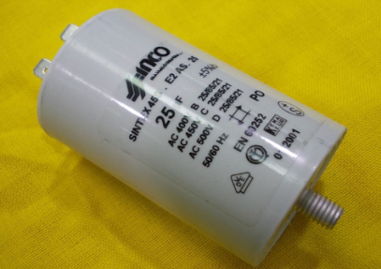
U1_L1_ALL3 Vocabulary Worksheet Solution
All images are licensed under BY Creative Commons.
A
B
M
9. mol
I
L
1. N
N
O
10. C/V
2. Cd
H
D
M
C
C
11. C/s
3. Pa
D
N
Q
12. J
G
4. µm
R
E
F
13. Hz
5. Ohm/m
R
A
14. W
P
6. A*m
I
O
15. m/s^2
G
7. J/C
E
H
P
F
16. K
8. dm^3/s
L
B
Q
17. Wb

