Slide 1
U1_L1_ALL2
FUNDAMENTALS OF PHYSICS
Class: 5 TL/CM Prof. Massimo Eccher
School year: 2017-18

Slide 2
Summary
What is Physics?
Measurement
Accuracy and Precision
SI base units
Derived quantities
Laws of Motion

Slide 4
What is Physics?
from ancient Greek: φυσική
translit. Phusikḗ
lit. Knowledge of nature
The study of matter, energy, and the interactions between them

Slide 5
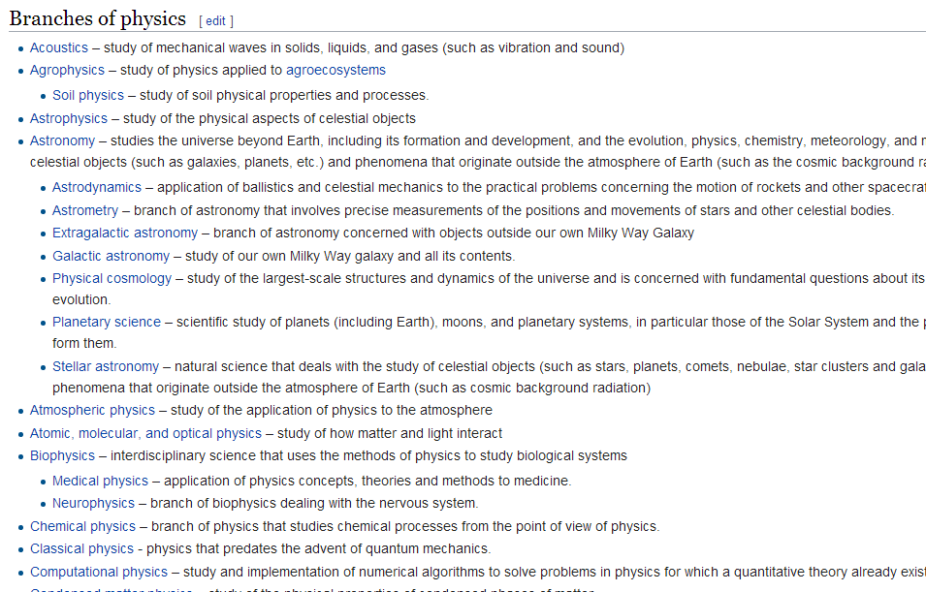
That easy?
Mmmm, this is what Wikipedia says..….

Slide 6
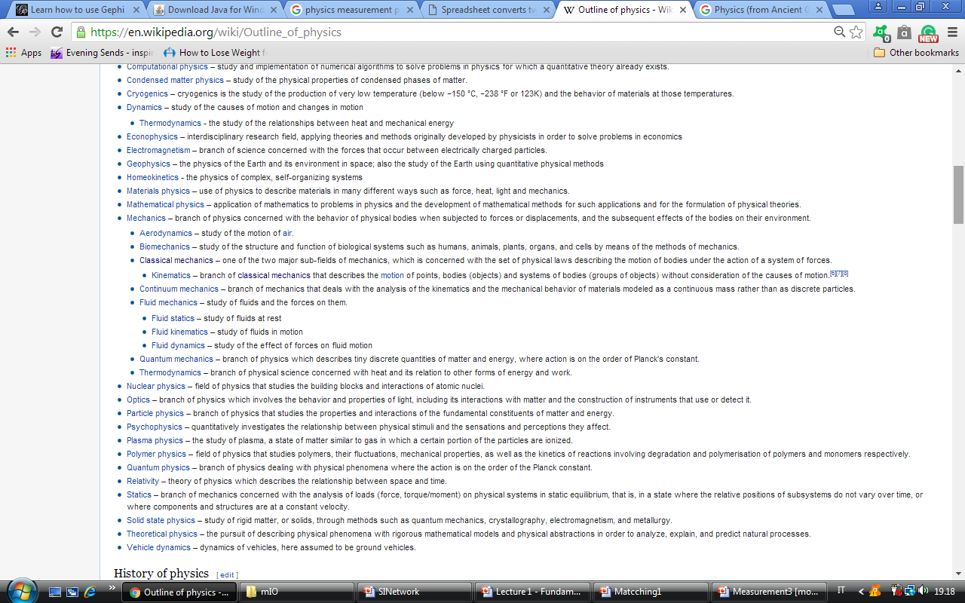
…….
Mmmm, this is what Wikipedia says..….

Slide 7
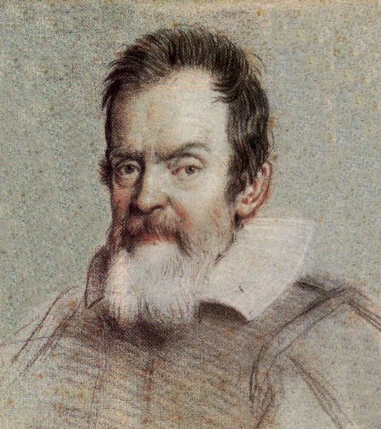
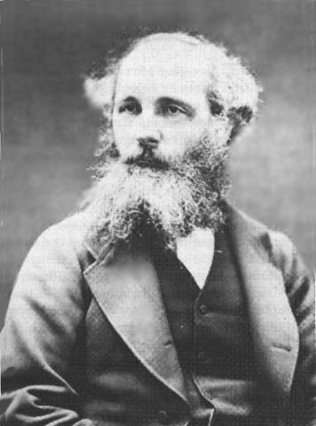
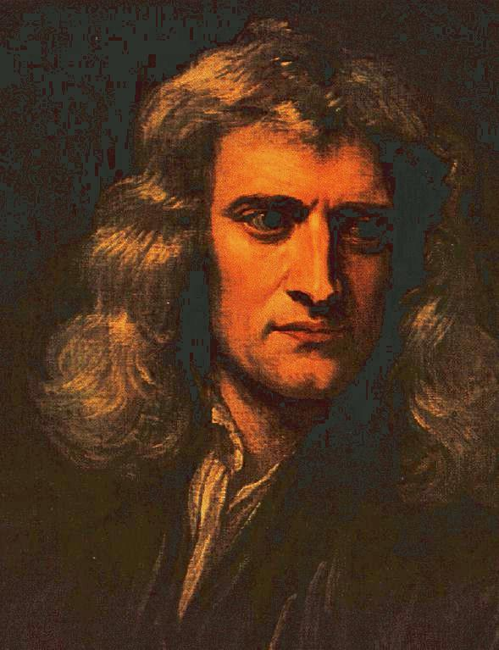
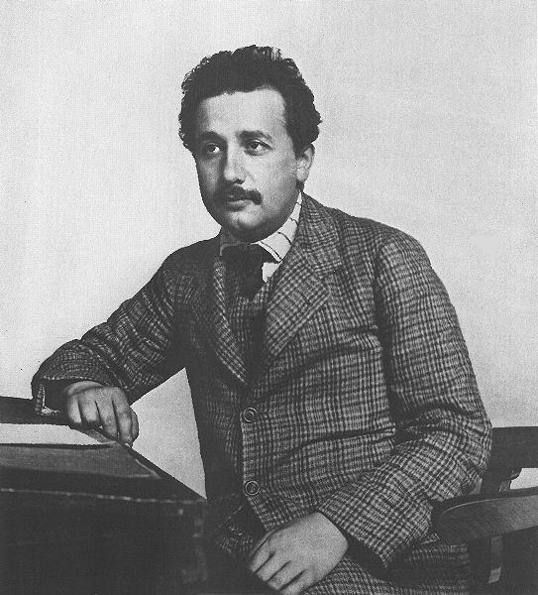
Physicist
4 pioneers you all heard about
Maxwell
Galileo
Newton
Electrodynamics
Einstein
Kinematics
Calculus
Relativity
Dynamics
Do you know others?
All images are licensed under BY Creative Commons.

Slide 8
Approach
State the problem
Investigations in physics generally follow the scientific method.
Gather information
Form a hypothesis
Test the hypothesis
Conclusions
Two options……
When is it time to make measurements?
Notes:
Observations + initial data collection leading to a question, hypothesis formulation and testing, interpret results + revise hypothesis if necessary, state conclusions

Slide 9
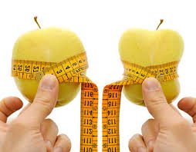
Measurement
Measurement is the assignment of a number to a characteristic of an object or event, which can be compared with other objects or events.
Characteristics: type, magnitude, unit, uncertainty.
BY Creative Commons
The first step in ensuring reproducibility is defining the units in which the measurements are made.

Slide 10
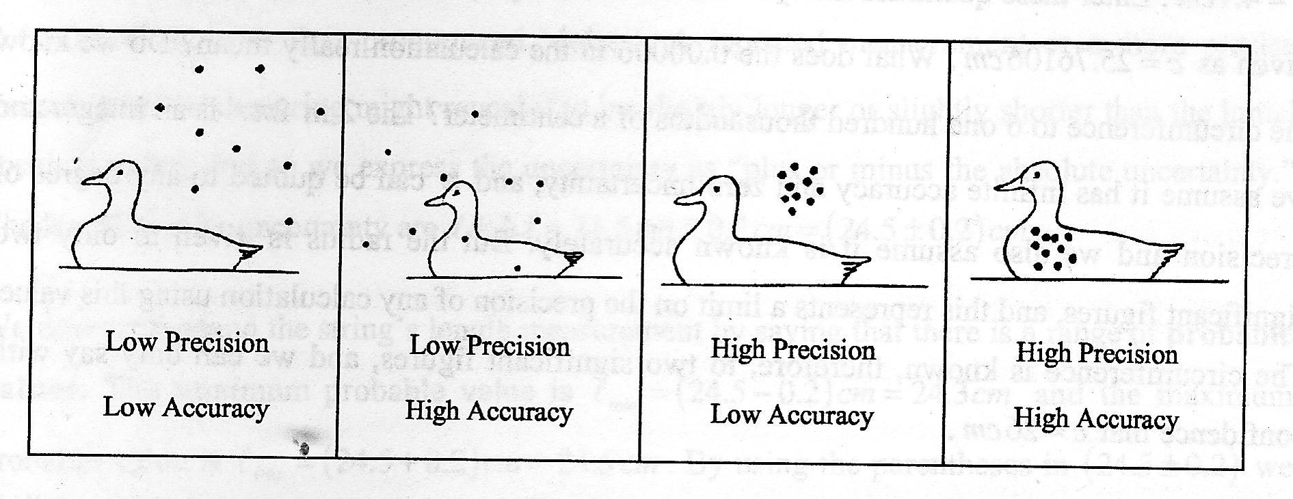
Physicist
http://bonlacfoods.com/worksheet/accuracy-and-precision-worksheet-3.html
Don’t confuse accuracy with precision.

Slide 11
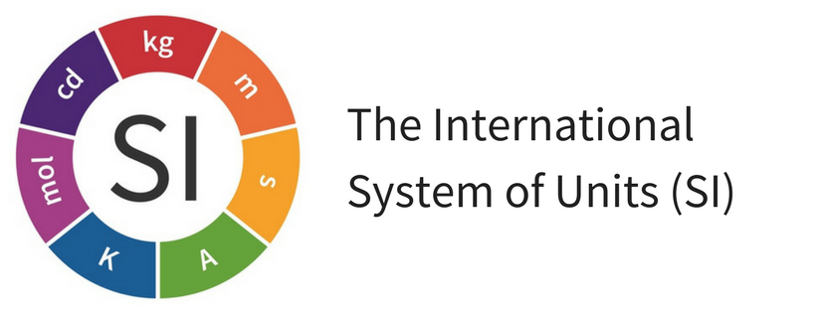
Source: https://www.unc.edu/~rowlett/units/sipm.html
Is an “universal system of measurement” used by all scientist worldwide, originally established in France in 1795.
Why does science need an universal system of measurement?
Think of the scientific method: results of an experiment must be able to be replicated by other scientists.

Slide 12
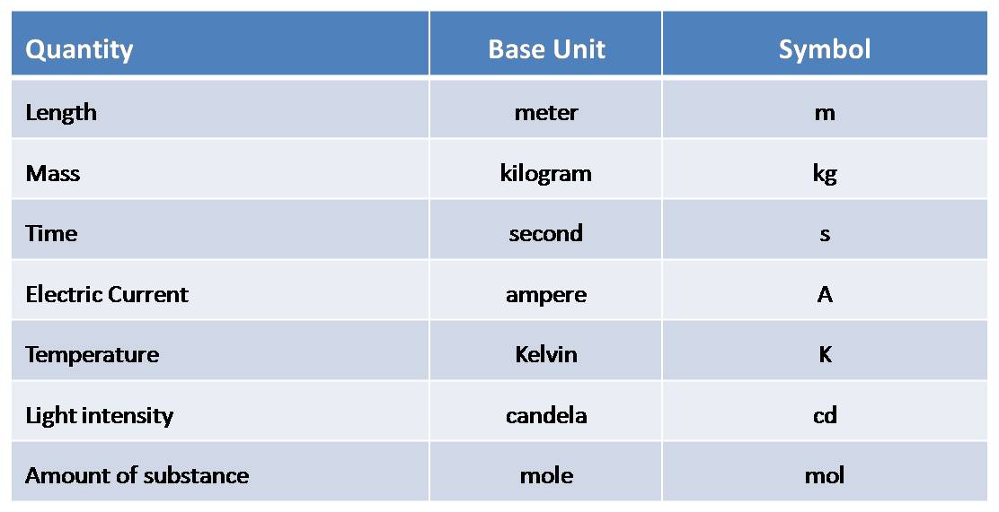
SI - Base Units
There are seven SI base units.

Slide 13
SI - Derived quantities
From these base units, all other SI units of measurement can be derived.
Examples: speed (v) = distance/time
acceleration (a) = velocity / time
others?

Slide 14
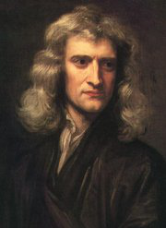
Laws of motion
Sir Isaac Newton (1643-1727) in his book Philosophiae Naturalis Principia Mathematica describes the motion of all objects on the scale we experience in our everyday lives. .
Today these laws are known as Newton’s Laws of Motion.
BY Creative Commons
I’m sure you all know what we are talking about…

Slide 15
Newton’s laws
An object in motion tends to stay in motion and an object at rest tends to stay at rest, unless acted upon by an unbalanced force.
2. Force equals mass times acceleration (F = ma).
3. For every action there is an equal and opposite reaction.
Any memories?

