Slide 1
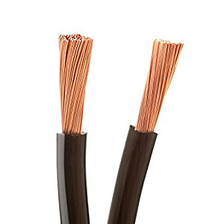
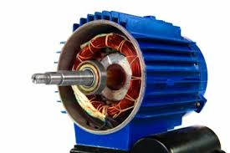
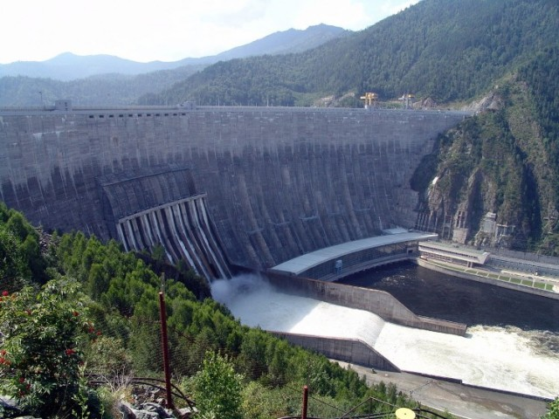
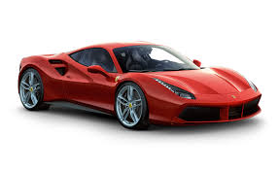
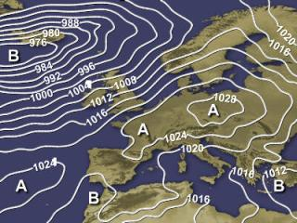
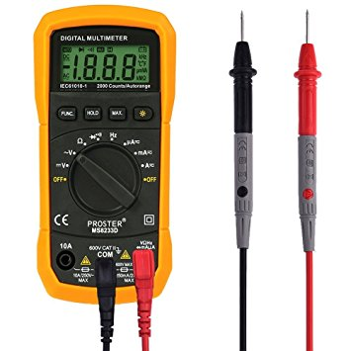
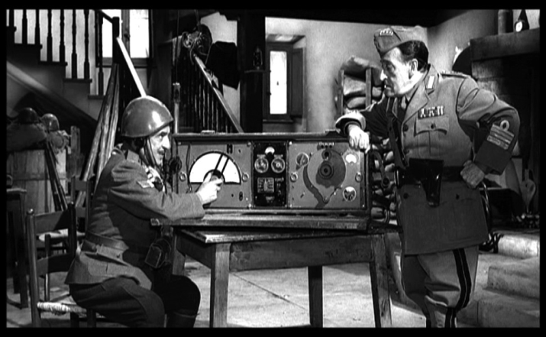
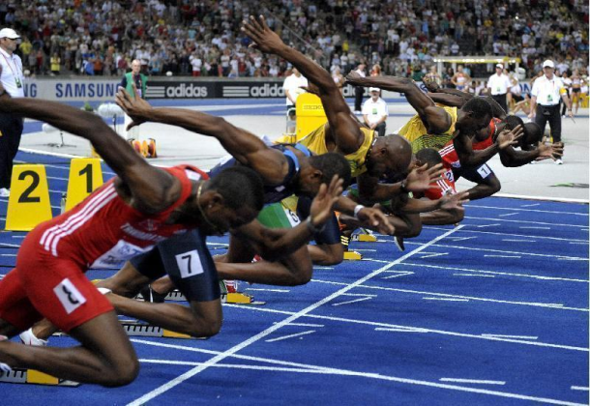
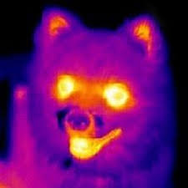
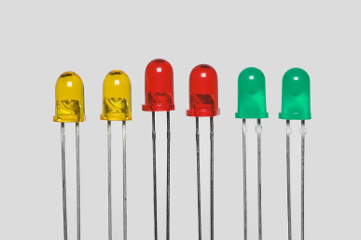
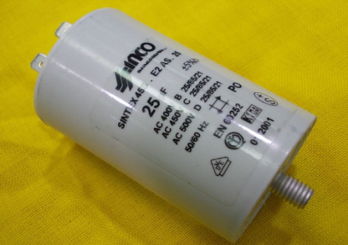
U1_L1_ALL1 Match the words to the pictures and find the intruder
Vocabulary Worksheet
All images are licensed under BY Creative Commons.
A
B
L
9. mol
I
1. N
10. C/V
2. Cd
D
M
C
11. C/s
3. Pa
N
12. J
4. µm
R
E
F
13. Hz
5. Ohm/m
14. W
P
6. A*m
O
15. m/s^2
G
7. J/C
H
16. K
8. dm^3/s
17. Wb
Q

