Slide 1
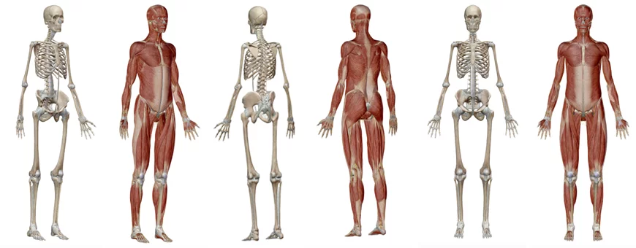
THE LOCOMOTOR SYSTEM
GROUP WORK

Slide 2
BONES
FUNCTIONS OF THE SKELETAL SYSTEM;
HOW MANY BONES THERE ARE IN OUR BODY;
IN HOW MANY GROUPS THEY MAY BE CLASSIFIED;
ON THE BASIS OF WHAT CAN BONES BE GROUPED;
WHICH ARE OUR MAIN BONES.
JOINTS
WHAT IS A JOINT;
FUNCTIONS;
WHICH ARE THE COMPONENTS OF A JOINT;
HOW MANY JOINTS THERE ARE IN OUR BODY;
ON THE BASIS OF WHAT CAN JOINTS BE GROUPED;
WHICH ARE OUR MAIN JOINTS.
MUSCLES
FUNCTIONS OF MUSCOLAR SYSTEM;
HOW MANY MUSCLES THERE ARE IN OUR BODY;
HOW THEY WORK;
IN HOW MANY GROUPS THEY MAY BE CLASSIFIED;
WHICH ARE OUR MAIN MUSCLES.

